Slide 1
Data Science: It’s Easy as Py!
Michael Becker
@beckerfuffle
#PyDataNYC
Notes:
Thanks everybody for coming to my talk! My name is Michael Becker, I work on the Data Ninjas Team at AWeber. AWeber is an email service provider located just outside of Philadelphia. I’m also the founder of the DataPhilly meetup with over 800 members.

Slide 2
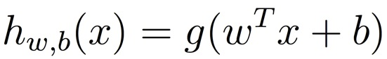
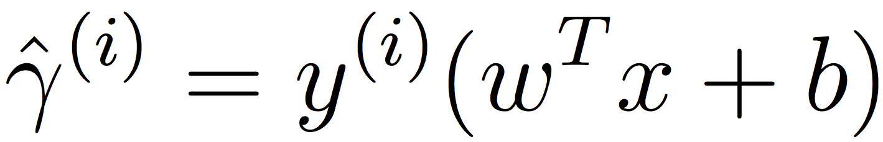
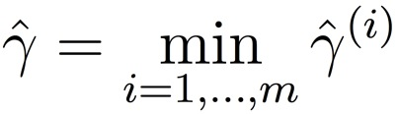
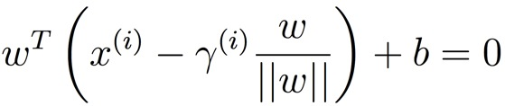
What My Coworkers Think I Do
@beckerfuffle
#PyDataNYC
Notes:
(PAUSE)
Working on the DAMN team at AWeber, I’ve introduced several predictive algorithms into our application. My co-workers think I’m some kind of math superhero, reading scholarly papers by day and fighting crime by night! The truth is much more sinister.

Slide 3

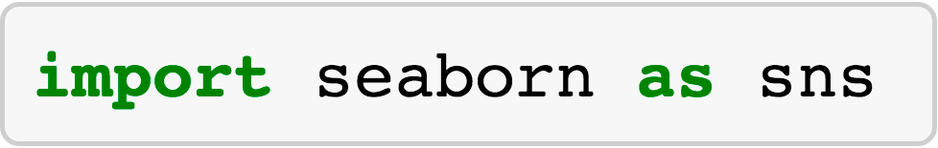

What I Actually Do
@beckerfuffle
#PyDataNYC
Notes:
(PAUSE)
Fortunately for me, I don’t have to be a genius to look like a superhero, I just have to use python! While I’ll cover some math in this talk, I’ll mainly be keeping things high-level.

Slide 4
What I'll Cover
What is Data Science?
@beckerfuffle
#PyDataNYC
Notes:
Okay, so what will I be covering today? To start off I’ll define what Data Science is.

Slide 5
What I'll Cover
What is Data Science?
The OSEMN process
@beckerfuffle
#PyDataNYC
Notes:
I’ll teach you the OSEMN Data Science process.

Slide 6
What I'll Cover
What is Data Science?
The OSEMN process
Writing a custom web scraper
@beckerfuffle
#PyDataNYC
Notes:
I’ll demonstrate how to create a custom web scraping bot

Slide 7
What I'll Cover
What is Data Science?
The OSEMN process
Writing a custom web scraper
Scrubbing the data
@beckerfuffle
#PyDataNYC
Notes:
I’ll convert the data to plain text.

Slide 8
What I'll Cover
What is Data Science?
The OSEMN process
Writing a custom web scraper
Scrubbing the data
Data Exploration
@beckerfuffle
#PyDataNYC
Notes:
I’ll explore the data using pandas, seaborn, and scikit-learn

Slide 9
What I'll Cover
What is Data Science?
The OSEMN process
Writing a custom web scraper
Scrubbing the data
Data Exploration
Predictive Modeling
@beckerfuffle
#PyDataNYC
Notes:
Finally I’ll walk you through creating a predictive model using scikit-learn

Slide 10
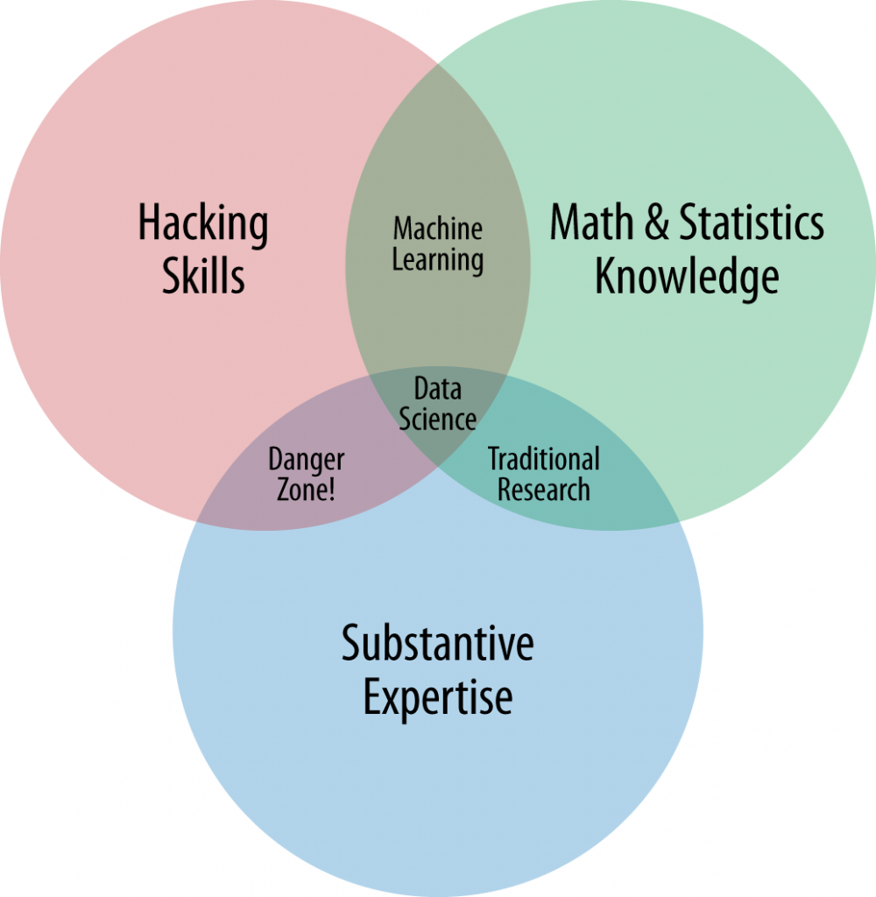
What is Data Science?
http://www.dataists.com/2010/09/the-data-science-venn-diagram/
@beckerfuffle
#PyDataNYC
Notes:
(PAUSE) What is Data Science, well there is a lot of disagreement on this subject but I like this Venn diagram created by Drew Conway which gives a good high level overview of what skills are involved in Data Science.
Conway argues that at a minimum, you need 3 main skills to be a good Data Scientist. Hacking skills, Math & statistics, and substantive expertise.
In the “Hacking Skills” circle, he includes things like “manipulating text files at the command-line” and “thinking algorithmically”
The Math & Statistics part is pretty straight forward.
Drew argues that these 2 pieces are not enough on their own, you also need to understand the data, you need domain knowledge and expertise.

Slide 11

@beckerfuffle
#PyDataNYC
Notes:
(PAUSE) I’m not sure if it was Hilary Mason who first coined the term OSEMN, but that’s certainly who I learned it from. OSEMN is a typical data science process followed by many data scientists. Let’s break it down.

Slide 12
OSEMN!
Obtain
@beckerfuffle
#PyDataNYC
Notes:
Obtain is pretty straight forward. To do Data Science, you first need data. Not all data is easy to access. Be prepared to jump through some hoops to obtain your datasets.

Slide 13
OSEMN!
Obtain
Scrub
@beckerfuffle
#PyDataNYC
Notes:
Okay, so you have your dataset, now what? If your lucky, your data will be well structured and easily parseable. But in reality, it’s rarely that simple. Messy data is the norm, not the exception. But don’t panic, scrubbing your data is just another part of the job!

Slide 14
OSEMN!
Obtain
Scrub
Explore
@beckerfuffle
#PyDataNYC
Notes:
To get the most out of your dataset, you need to understand it. This is where the Explore step comes in. This can be as simple as looking at your raw data in a text editor, or as advanced as running machine learning algorithms on your data.

Slide 15
OSEMN!
Obtain
Scrub
Explore
Model
@beckerfuffle
#PyDataNYC
Notes:
Sometimes you want to predict the future using your data! This is usually where machine learning comes into the picture. The goal here is to maximize predictive power by minimizing the level of error.

Slide 16
OSEMN!
Obtain
Scrub
Explore
Model
iNterpret
@beckerfuffle
#PyDataNYC
Notes:
A model isn’t useful on it’s own. This is where the interpret step comes in. Often while interpreting the results of your model, you’ll identify areas for improvement which will allow you to iterate and improve on it. Even a bad model can lead to useful insights.

Slide 17
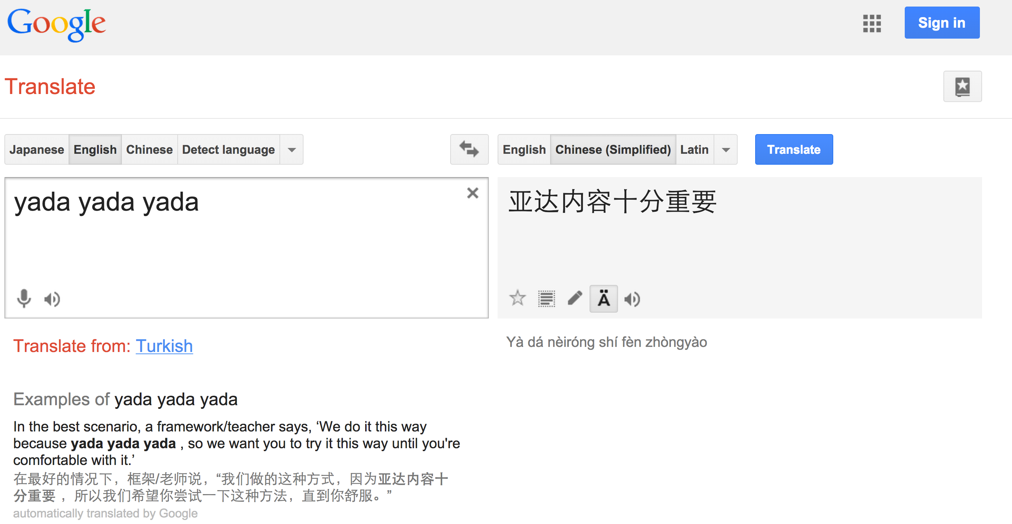
Language Classification
@beckerfuffle
#PyDataNYC
Notes:
(PAUSE) In this talk I’m going to walk you through the OSEMN process by building a language classification algorithm from scratch. A language classification algorithm will predict the language of some text. For example, you might give it the text “yada yada yada” and the classifier would classify this as English.

Slide 18
Language Classification
@beckerfuffle
#PyDataNYC
Notes:
Language classification can be useful on its own. For example, I’ve used this algorithm to break down AWeber’s customers by the language they use, in the emails they send.

Slide 19
Language Classification
@beckerfuffle
#PyDataNYC
Notes:
Language classification can also be useful as a preprocessing step. For example, Google likely uses it to automatically detect what language you’re typing into google translate, and Google Chrome probably uses it to detect the language of the webpages your viewing.

Slide 20

Obtain
API?!
Where we’re going we don’t need APIs!
@beckerfuffle
@beckerfuffle
#PyDataNYC
#PyDataNYC
Notes:
(PAUSE) Step one of OSEMN is to obtain the data. In the case of our language classification model, we need text in a bunch of different languages. Fortunately, Wikipedia has an abundant supply of this kind of data. There are Wikipedia datasets available online, but that’s no fun! Let’s build our own!

Slide 21
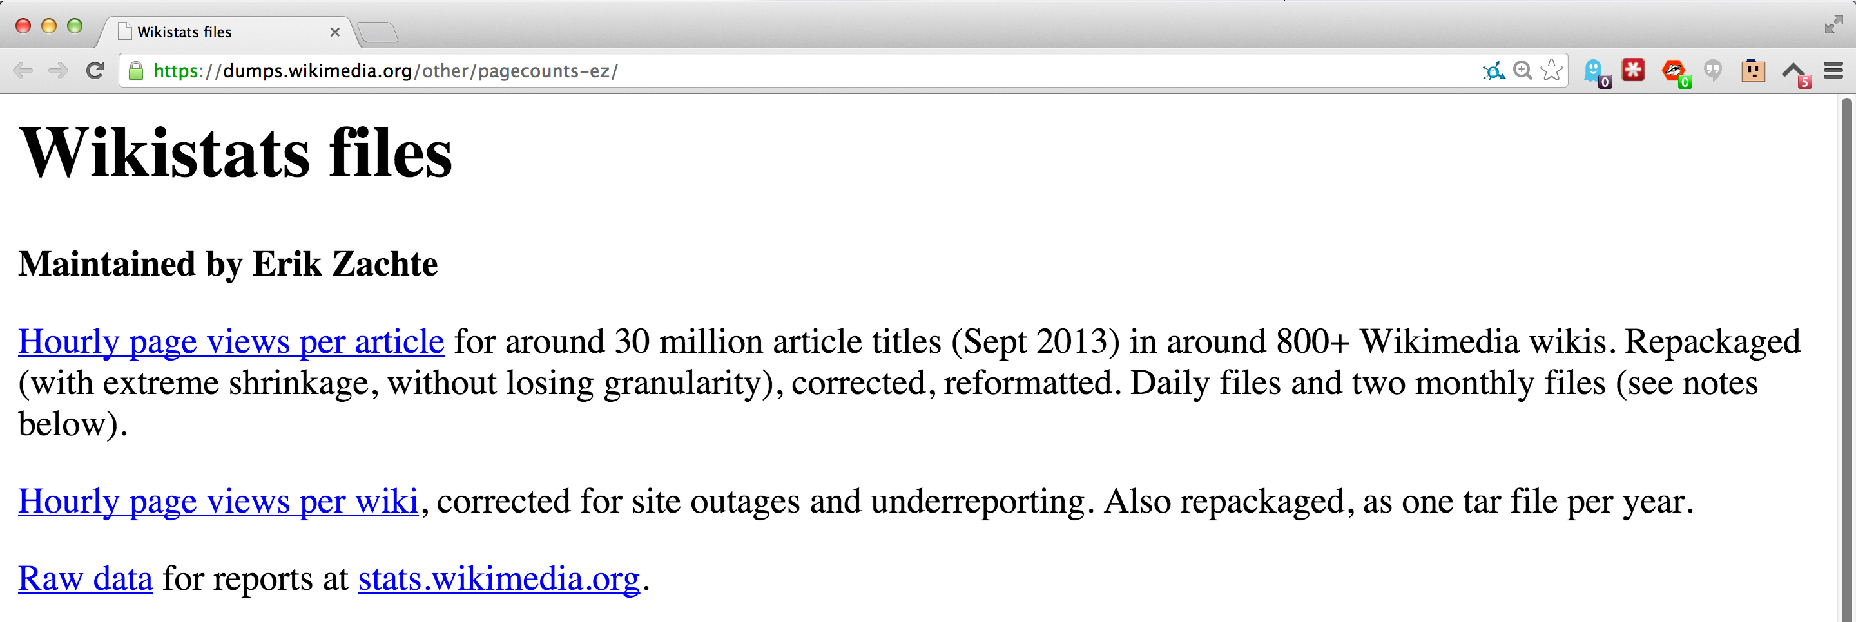
Scrape All The Things!
@beckerfuffle
#PyDataNYC
Notes:
(PAUSE) To start off, I grabbed a list of hourly page views. I wrote some scripts to aggregate this data for several months, and compiled a list of the top articles per language.

Slide 22
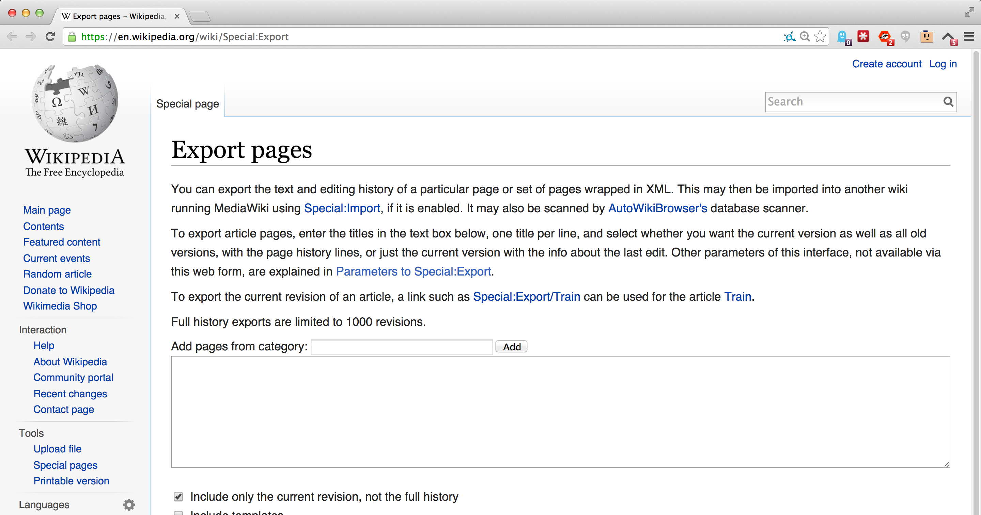
Scrape All The Things!
@beckerfuffle
#PyDataNYC
Notes:
(PAUSE) Next I used the Special:Export page for each Wikipedia to export the pages I wanted.

Slide 23
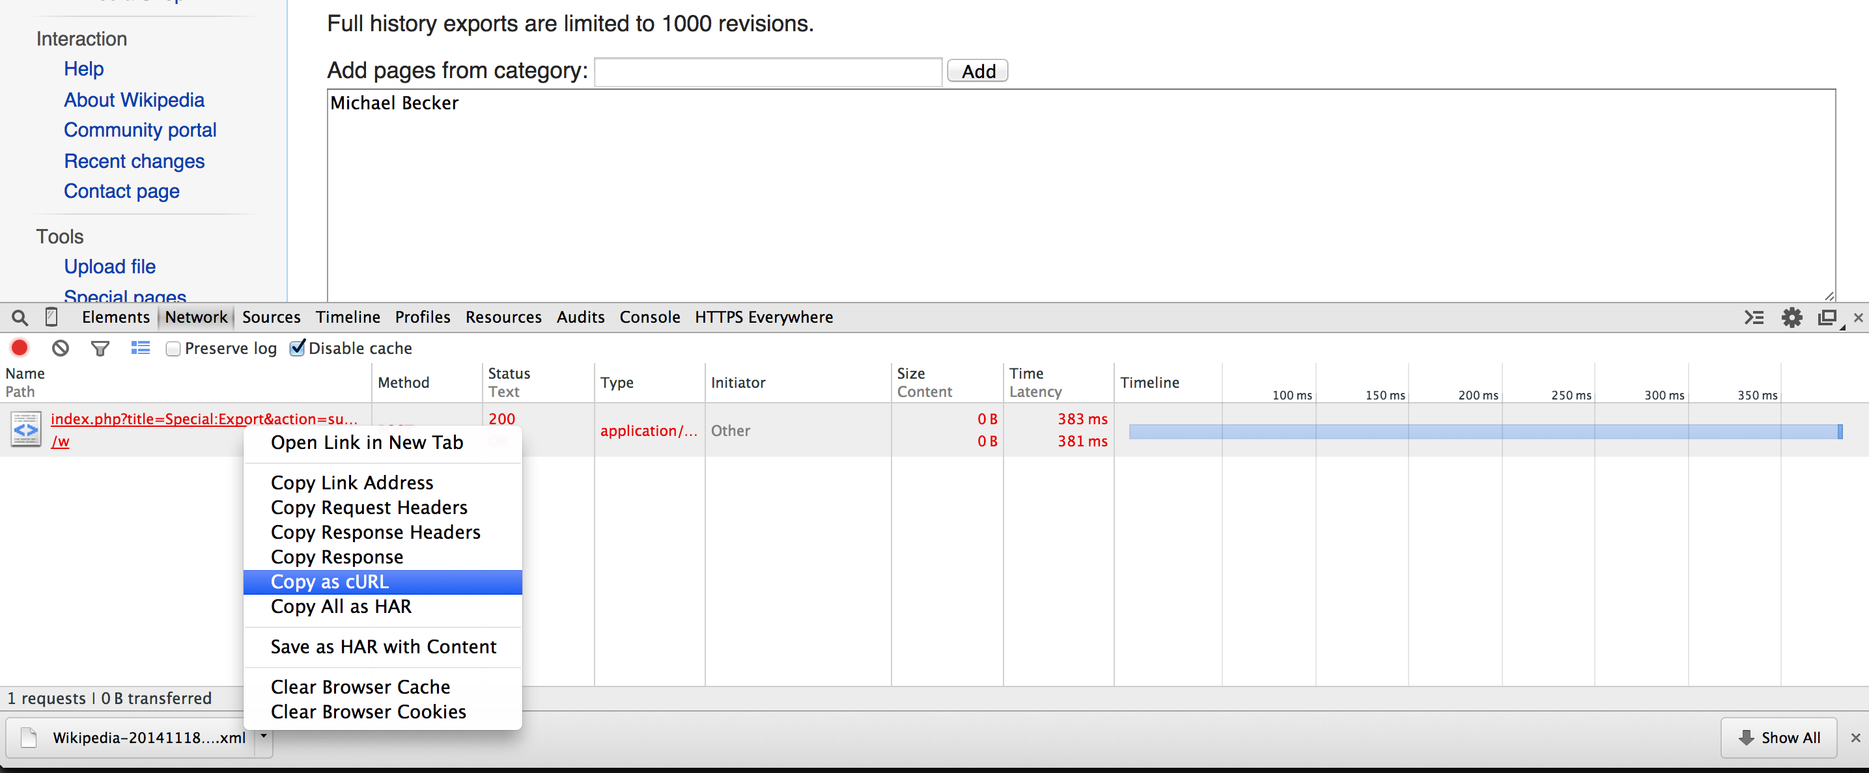
Scrape All The Things!
@beckerfuffle
#PyDataNYC
Notes:
(PAUSE) This task was made trivially scriptable via the use of the “Copy as cURL” command in the Chrome Developer Tools.

Slide 24
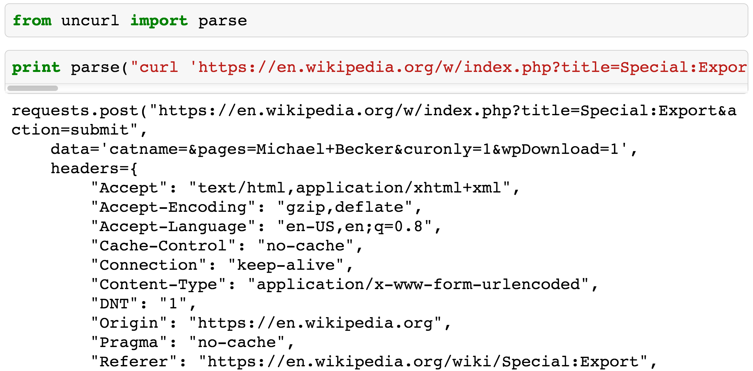
Scrape All The Things!
@beckerfuffle
#PyDataNYC
Notes:
(PAUSE) Add to this the nifty uncurl library, and you have an instant Python bot!

Slide 25

Scrub
@beckerfuffle
@beckerfuffle
#PyDataNYC
#PyDataNYC
Notes:
(PAUSE) Now that we’ve Obtained out our data, the second step is to scrub it. Our dumps are in xml format, so we’ll need to pull the articles out of the xml.

Slide 26
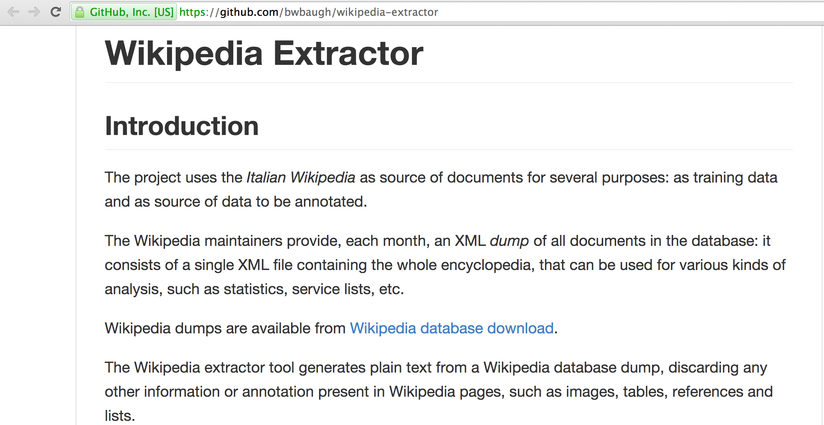
Scrub
@beckerfuffle
#PyDataNYC
Notes:
(PAUSE) Luckily I found some Python code that already does this called, wikipedia-extractor.

Slide 27
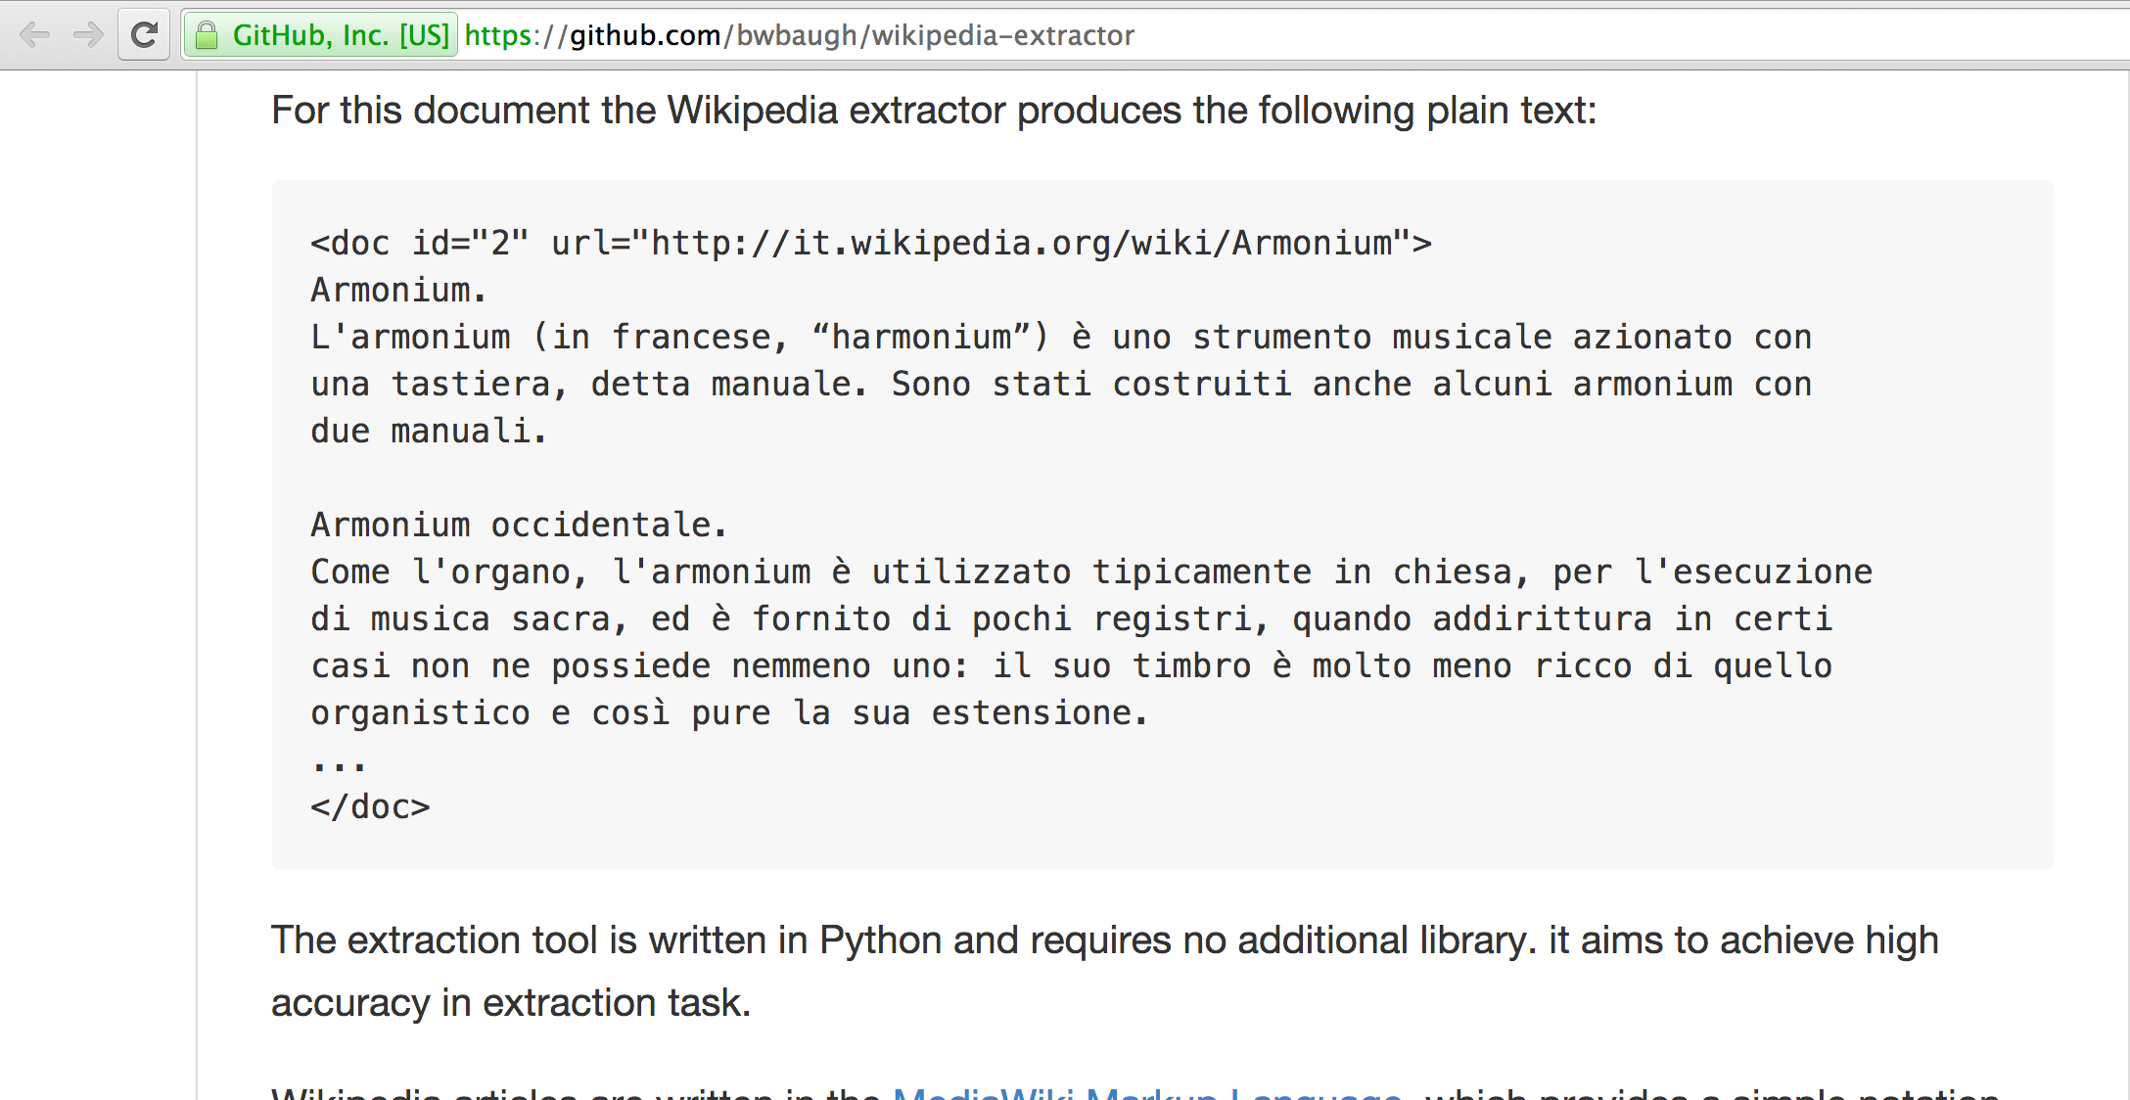
Scrub
@beckerfuffle
#PyDataNYC
Notes:
(PAUSE) This tool produces output that looks a lot like valid XML, but it’s not!

Slide 28
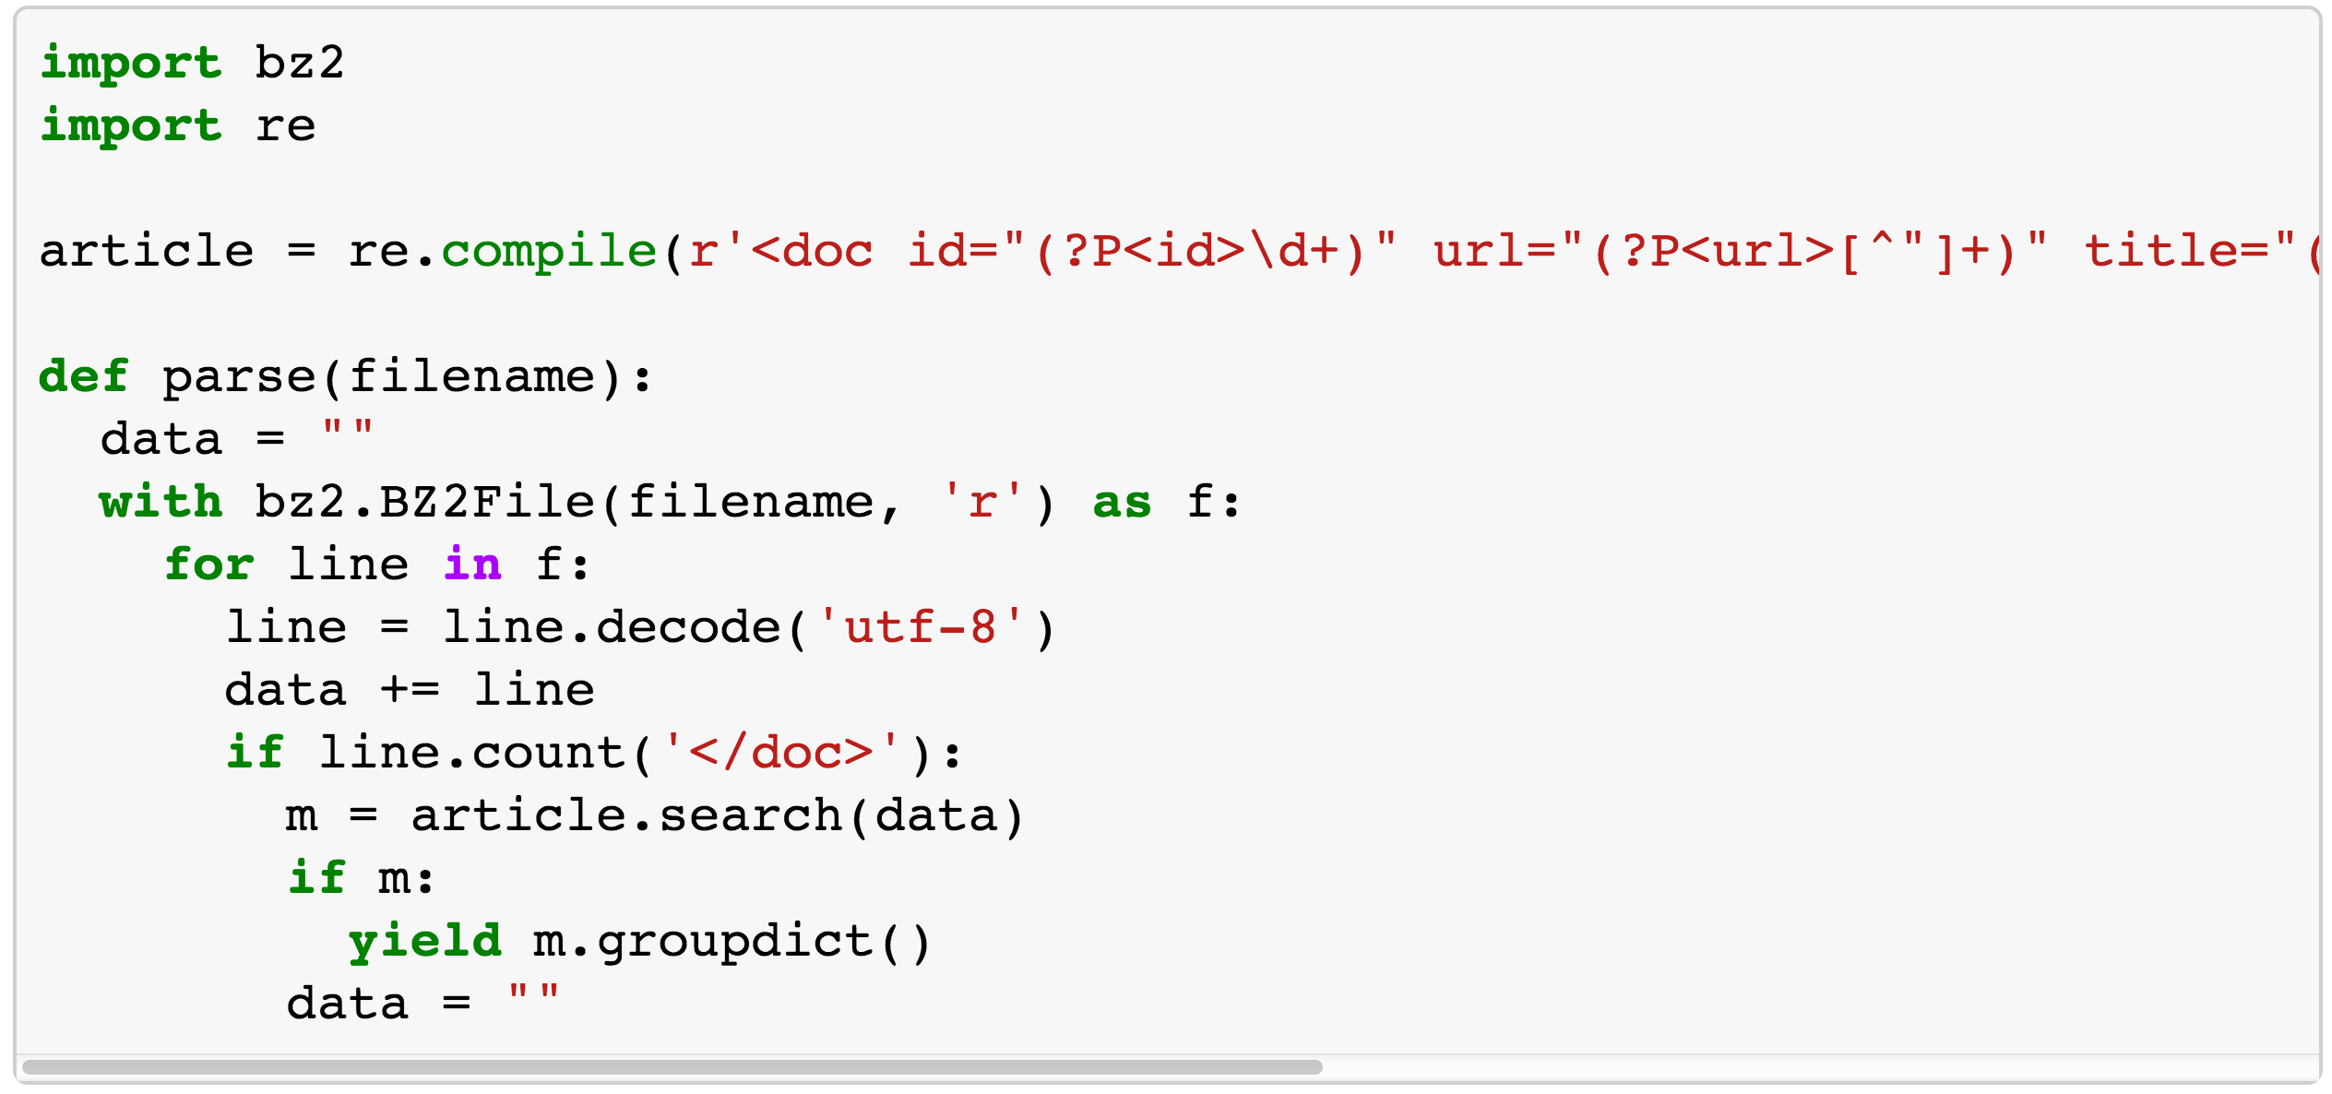
Scrub
@beckerfuffle
#PyDataNYC
Notes:
(PAUSE) The code was a bit ugly, so rather than try to fix it I just wrote a simple regex to parse it!

Slide 29

Explore
@beckerfuffle
@beckerfuffle
#PyDataNYC
#PyDataNYC
Notes:
(PAUSE) Alright, now that we’ve scrubbed our data, let’s explore!

Slide 30
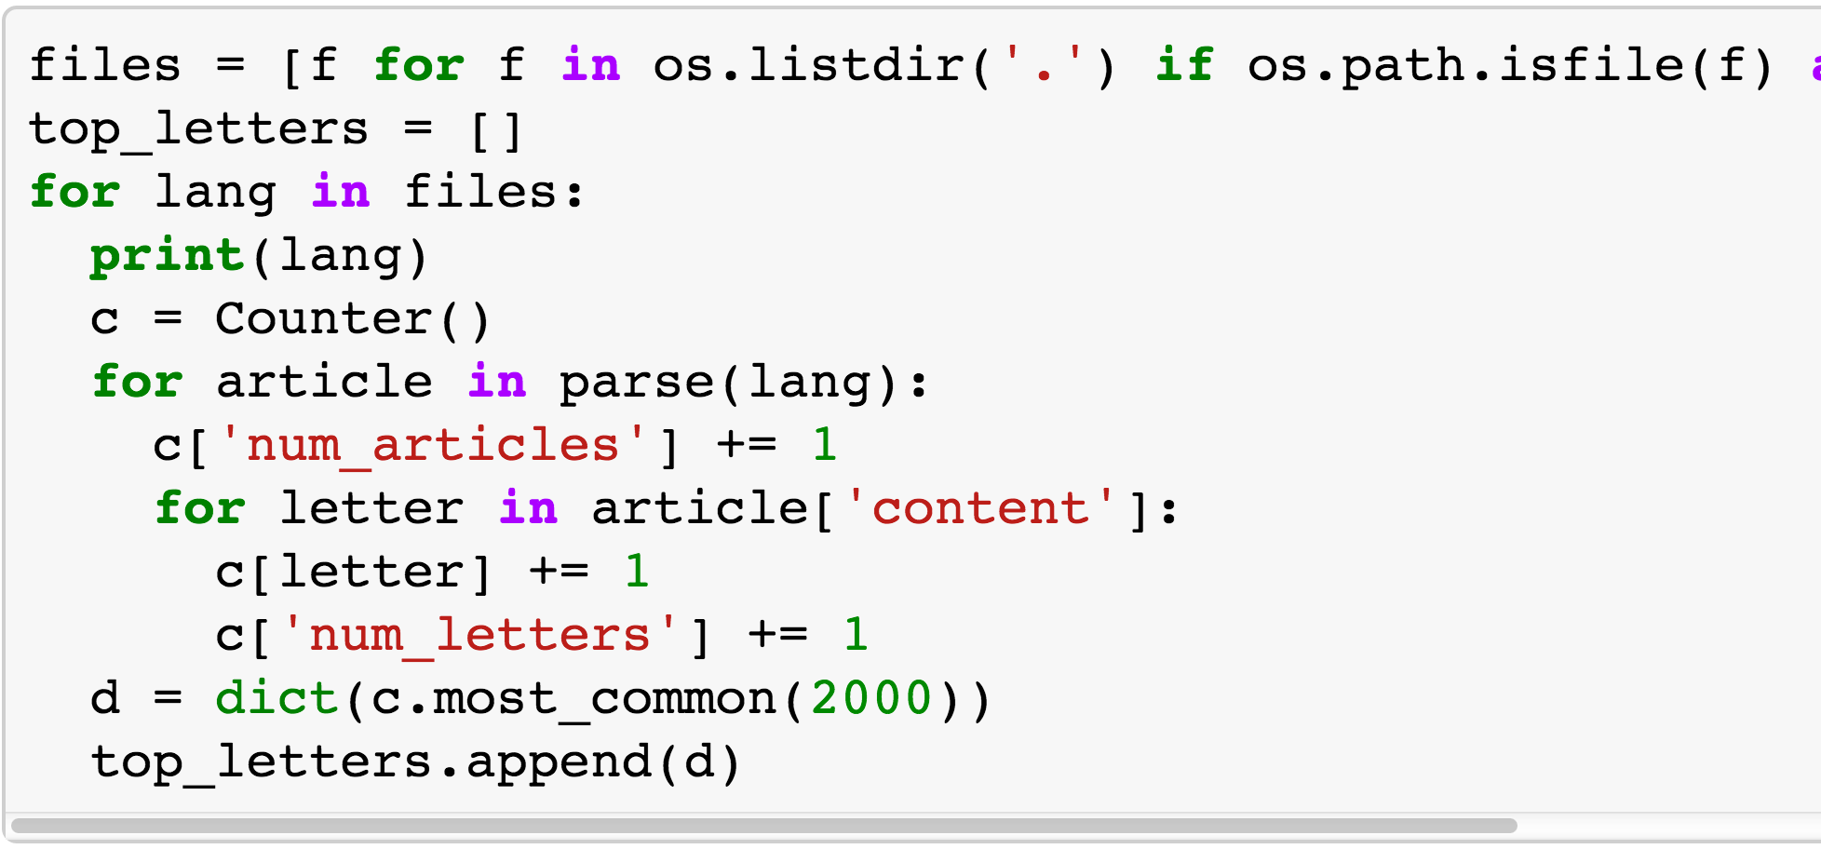
Explore
@beckerfuffle
#PyDataNYC
Notes:
(PAUSE) To start off, I counted the number of times each character occurs in each language and grabbed the top 2000 from each.

Slide 31
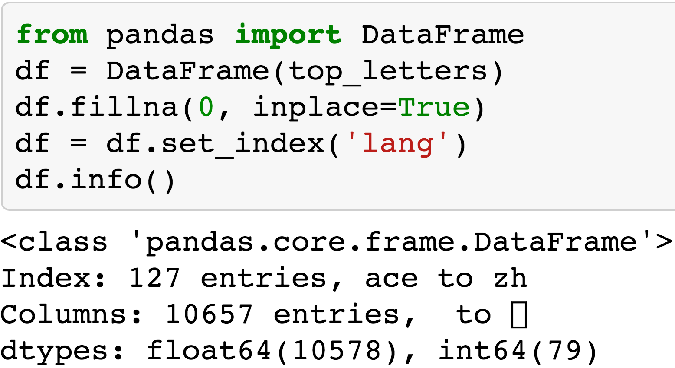
Pandas
@beckerfuffle
#PyDataNYC
Notes:
(PAUSE) Storing the data as a list of dictionaries makes it easy to load into a pandas DataFrame! You can think of a DataFrame as a mix between an Excel spreadsheet and a SQL database, but Python!

Slide 32
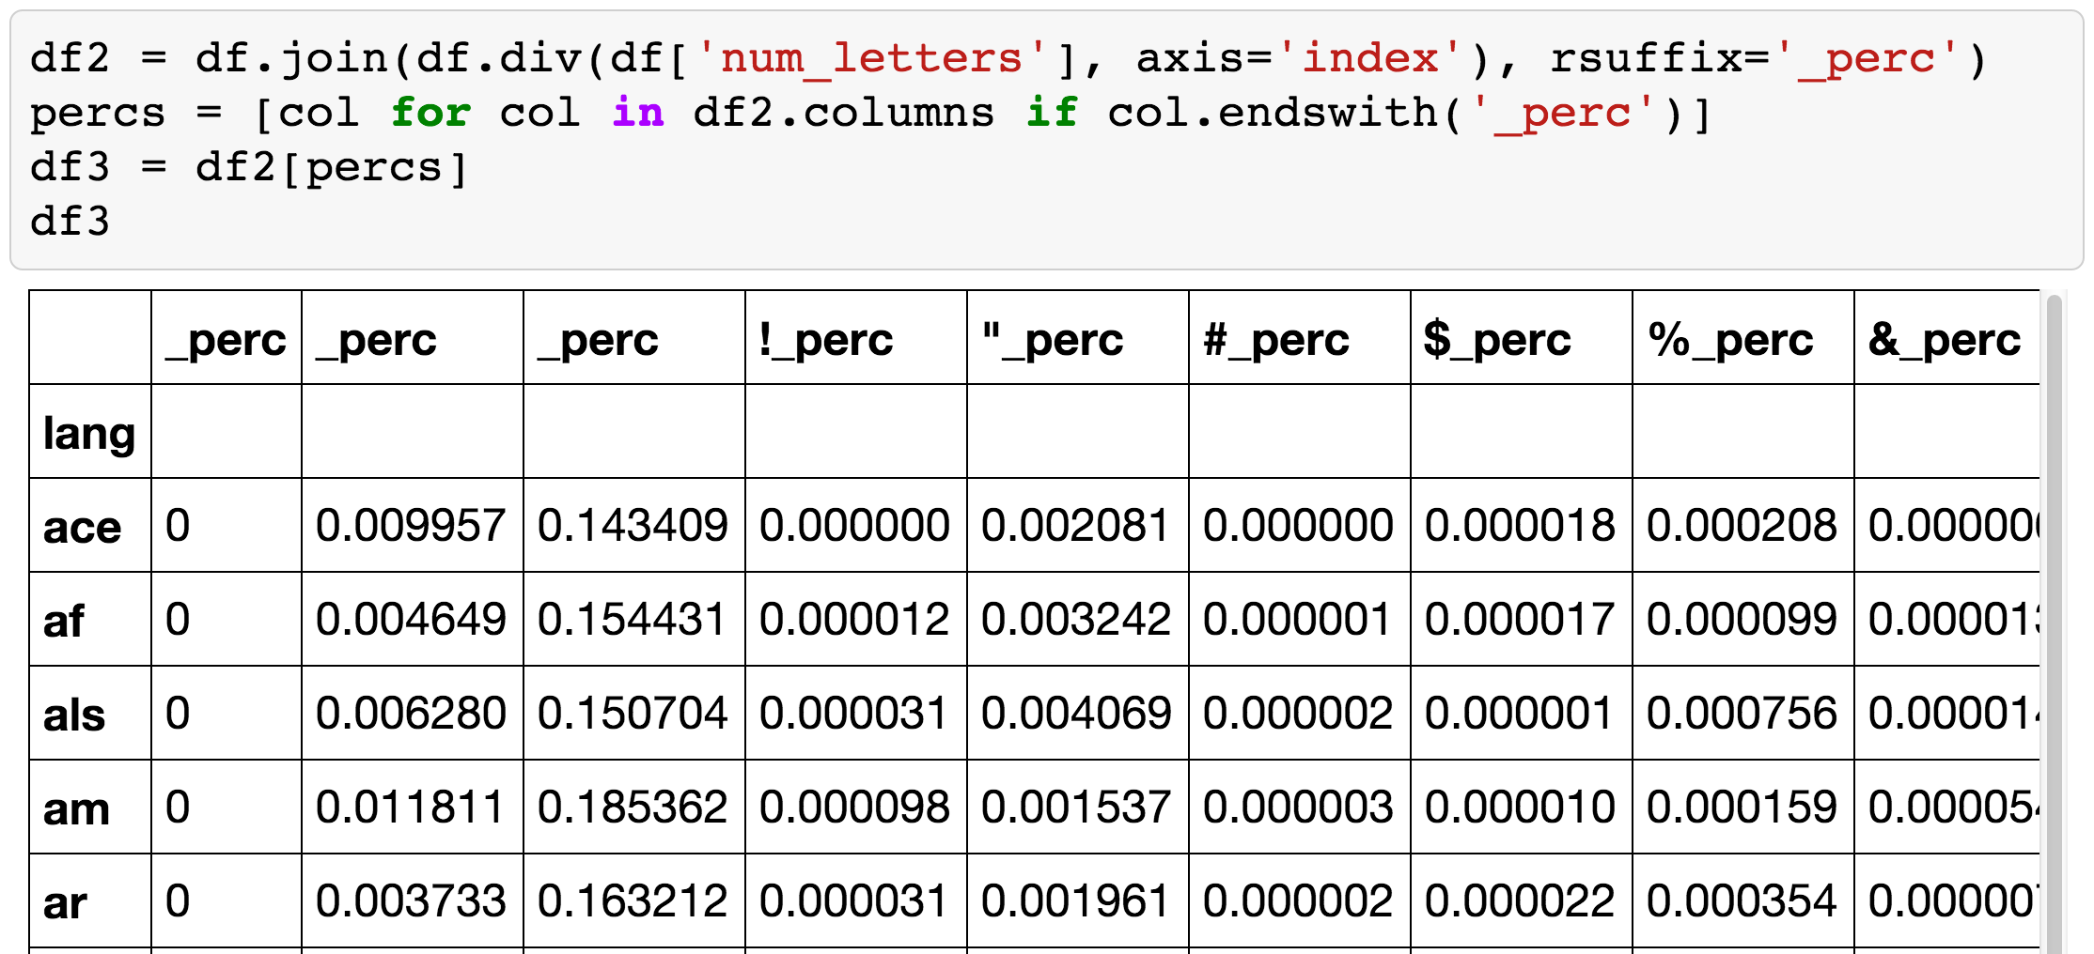
Pandas
@beckerfuffle
#PyDataNYC
Notes:
We can calculate percentages from our letter counts using the div method.

Slide 33
Pandas
@beckerfuffle
#PyDataNYC
Notes:
We can add these to as new columns to our DataFrame using the join method.

Slide 34
Pandas
@beckerfuffle
#PyDataNYC
Notes:
(PAUSE) And if you’re using Pandas in IPython-Notebook, you can easily display the contents for inspection.

Slide 35
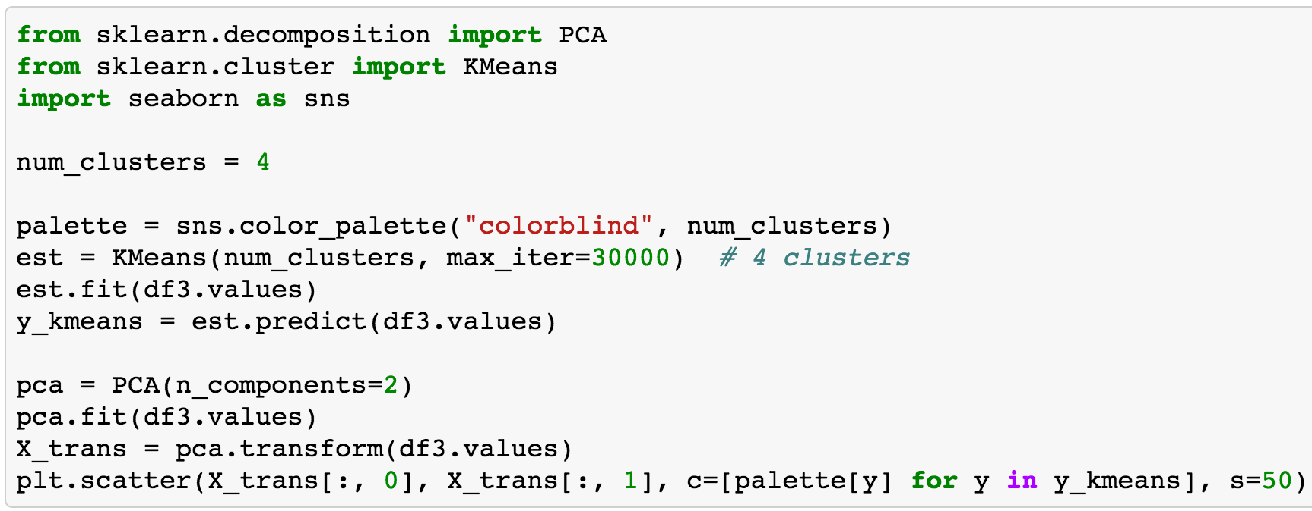
Visualize
@beckerfuffle
#PyDataNYC
Notes:
Alright so now let’s use 2 unsupervised machine learning techniques, to visualize our data.
There’s a lot going on here, so let’s break it down a little.

Slide 36
Visualize
@beckerfuffle
#PyDataNYC
Notes:
First we run the KMeans clustering algorithm on our letter percentages. KMeans automatically groups our data together based on similarity.

Slide 37
Visualize
@beckerfuffle
#PyDataNYC
Notes:
Next we run an algorithm called Principal Component Analysis on our data. We’re using PCA to reduce our number of columns from 10-thousand, to 2. The reason for this will become clearer in the next slide.

Slide 38
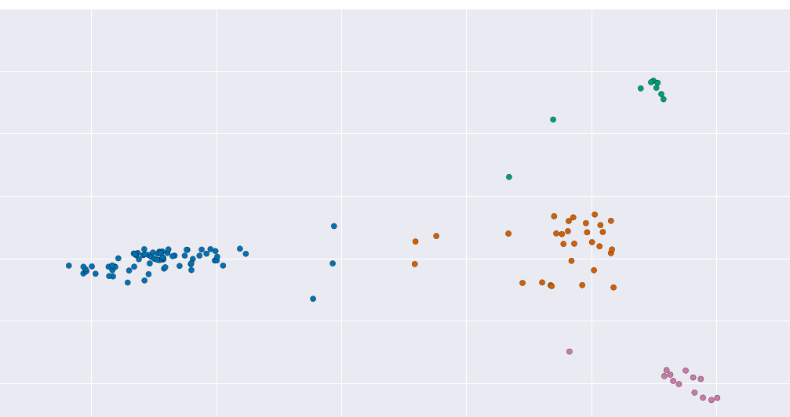
Visualize
@beckerfuffle
#PyDataNYC
Notes:
(PAUSE) Finally we plot the results. Since our data only has 2 dimensions, it’s easy to plot! The color of each point corresponds to its cluster number. We can see that with 4 clusters, there is a pretty clear separation of our languages.

Slide 39
Visualize
@beckerfuffle
#PyDataNYC
Notes:
One thing I noticed right away when I plotted the data like this was that there are some clear outliers. Digging into the details revealed that most of these languages use their own unique character sets.

Slide 40
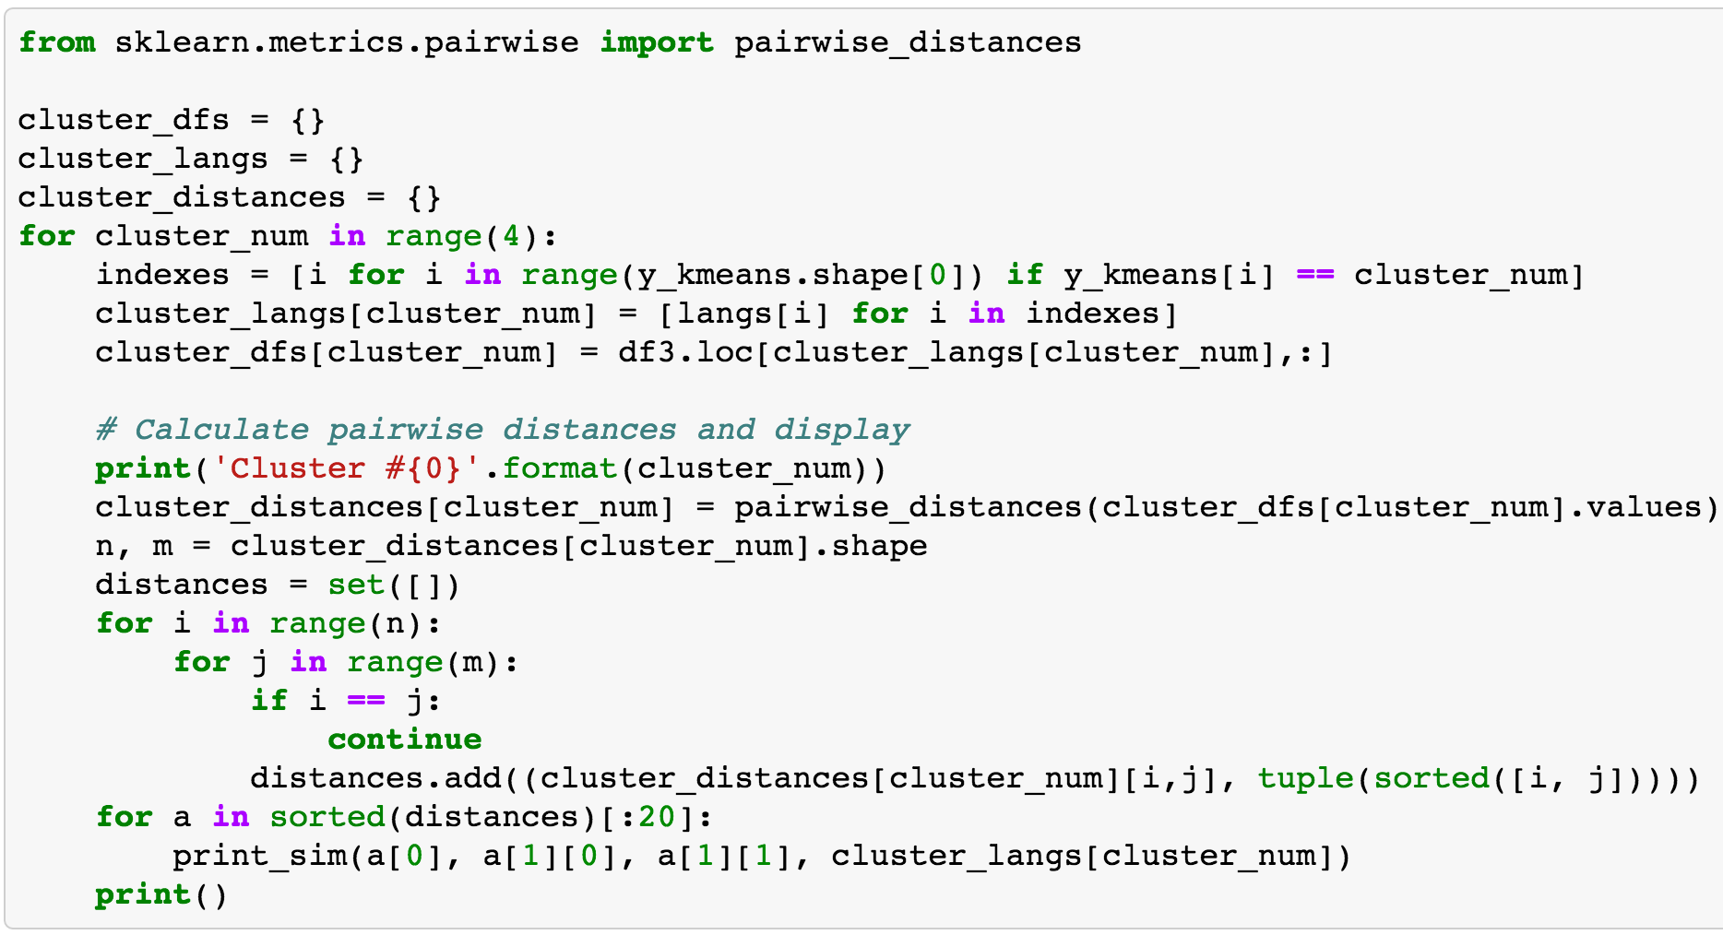
Explore More
@beckerfuffle
#PyDataNYC
Notes:
(PAUSE) We can also use the pairwise_distances function from scikit-learn to find the languages that are most similar. This function calculates the Euclidean distance between each pair of points. The smaller the distance, the more similar the data points are.

Slide 41
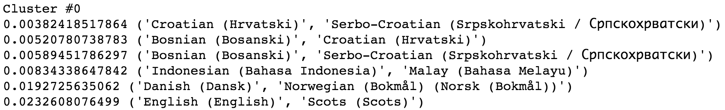
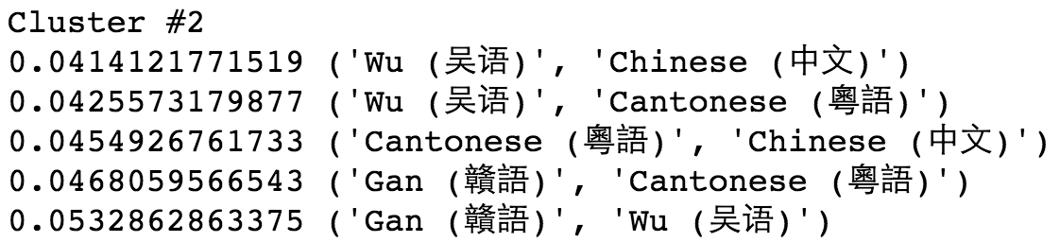
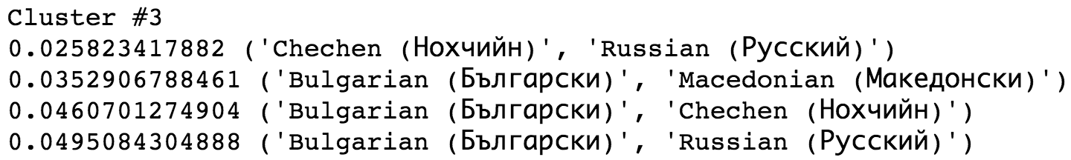
Explore More
@beckerfuffle
#PyDataNYC
Notes:
(PAUSE) We can see that the most similar languages are in our first cluster.

Slide 42
Explore More
@beckerfuffle
#PyDataNYC
Notes:
Croatian, Serbo-Croatian and Bosnian are the most similar.

Slide 43
Explore More
@beckerfuffle
#PyDataNYC
Notes:
followed by Indonesian & Malay.

Slide 44
Explore More
@beckerfuffle
#PyDataNYC
Notes:
Danish & Norwegian

Slide 45
Explore More
@beckerfuffle
#PyDataNYC
Notes:
and English & Scots.
Some of these really similar languages will be useful for benchmarking our language classifier later on.

Slide 46
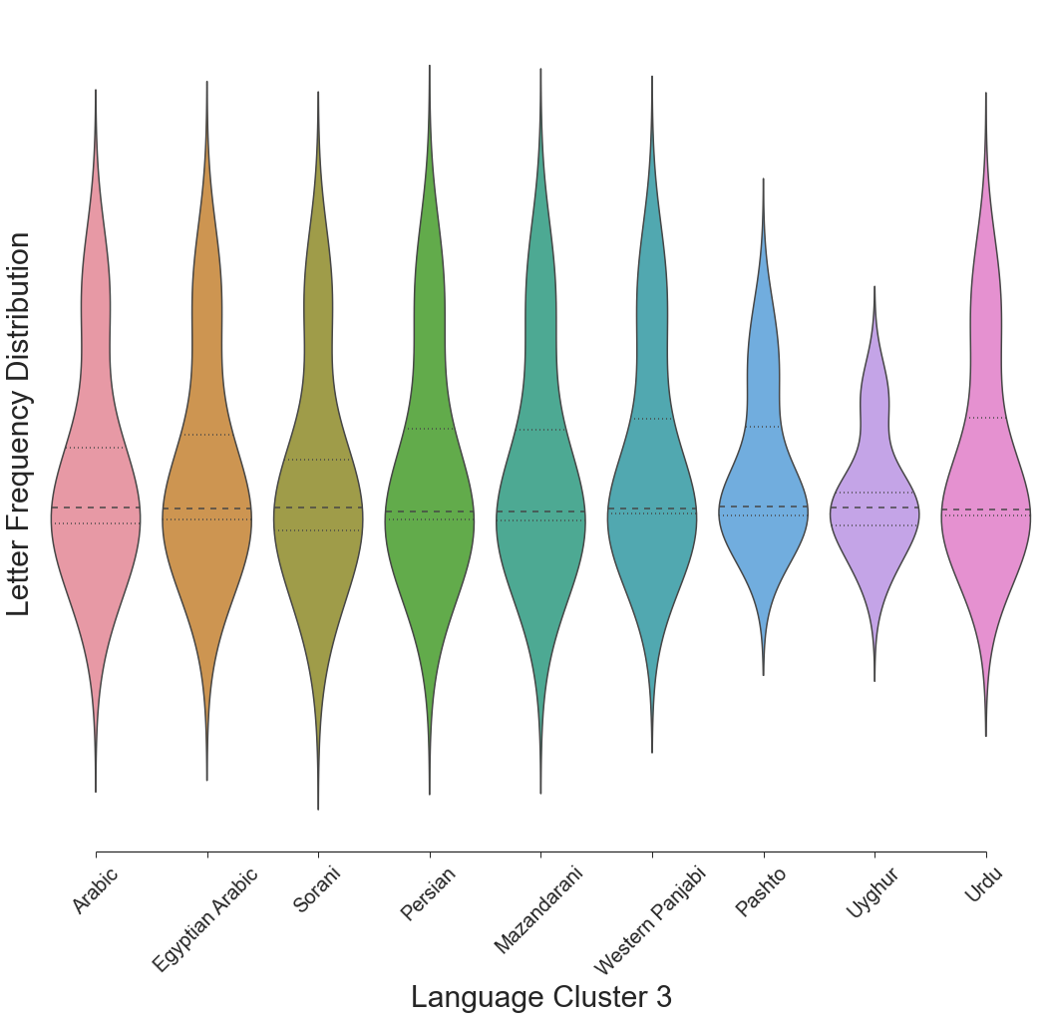
Explore Even More
@beckerfuffle
#PyDataNYC
Notes:
(PAUSE) Finally, Seaborn has some really awesome graphs built-in which we can also use to visualize the similarity of languages. Here we have a violin plot which is similar to a box plot except it shows the distribution in addition to the 25th, 50th, and 75th percentiles.

Slide 47
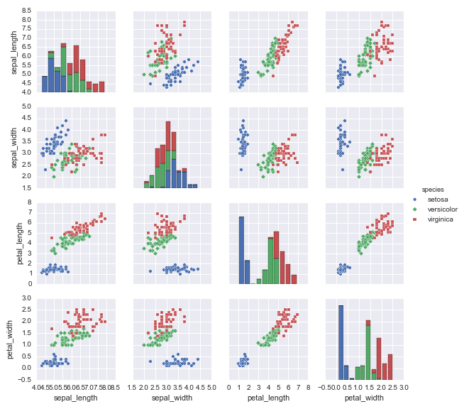
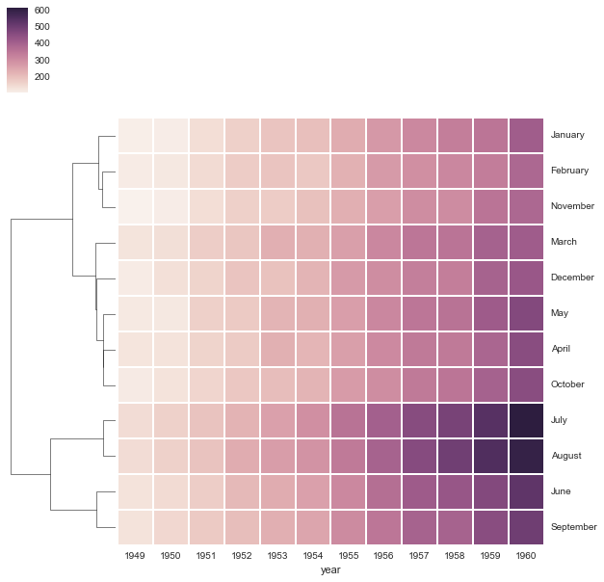
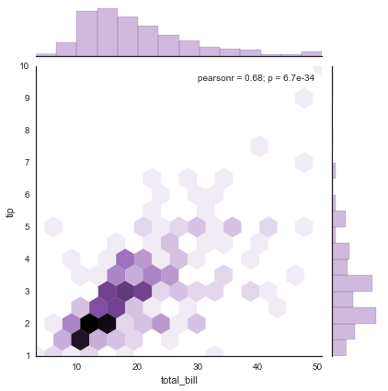
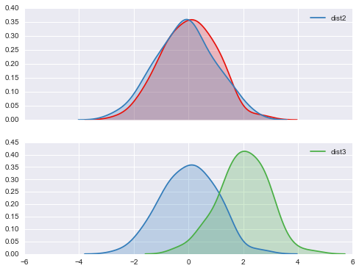
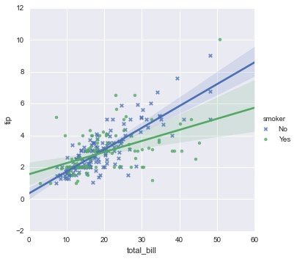
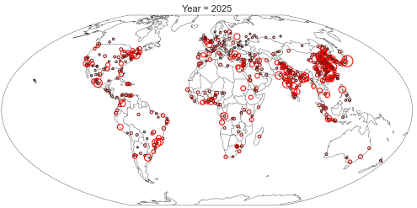
But There’s More!
@beckerfuffle
#PyDataNYC
Notes:
(PAUSE) Seaborn has a ton of other awesome graphs built in! Here’s a few other examples!

Slide 48

@beckerfuffle
@beckerfuffle
#PyDataNYC
#PyDataNYC
Notes:
(PAUSE) Now that we’ve finished exploring our data, it’s time to build our Model! Our model is called a “supervised” model. So let’s start off, by defining what a supervised model is.

Slide 49
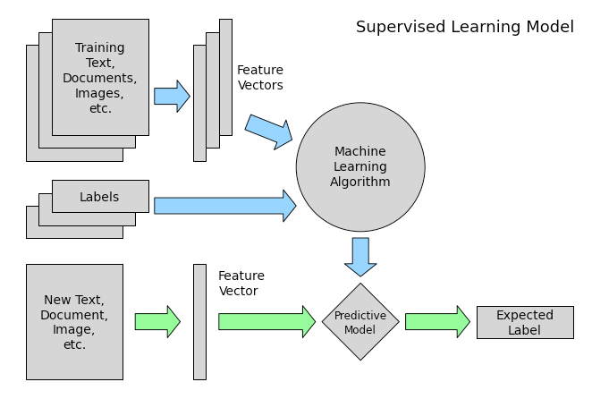
Supervised Learning
@beckerfuffle
#PyDataNYC
Notes:
1) You start off with some input. In our case we have Wikipedia articles as input. This is called the training set.

Slide 50
Supervised Learning
@beckerfuffle
#PyDataNYC
Notes:
2) You also have labels for each piece of training data. In our case our labels are the languages.
Note how this differs from the KMeans and PCA algorithms from before. They didn’t use the labels. That’s the difference between supervised and unsupervised learning.

Slide 51
Supervised Learning
@beckerfuffle
#PyDataNYC
Notes:
3) Next you convert the data to a numerical form.

Slide 52
Supervised Learning
@beckerfuffle
#PyDataNYC
Notes:
4) Then you train your machine learning algorithm using your vectorized training data, and the labels as input. This is often referred to as fitting your model.
5) At this point you have a model that can take a new piece of unlabeled data, and predict the label.
(PAUSE) Alright, so let’s see how this works in practice.

Slide 53
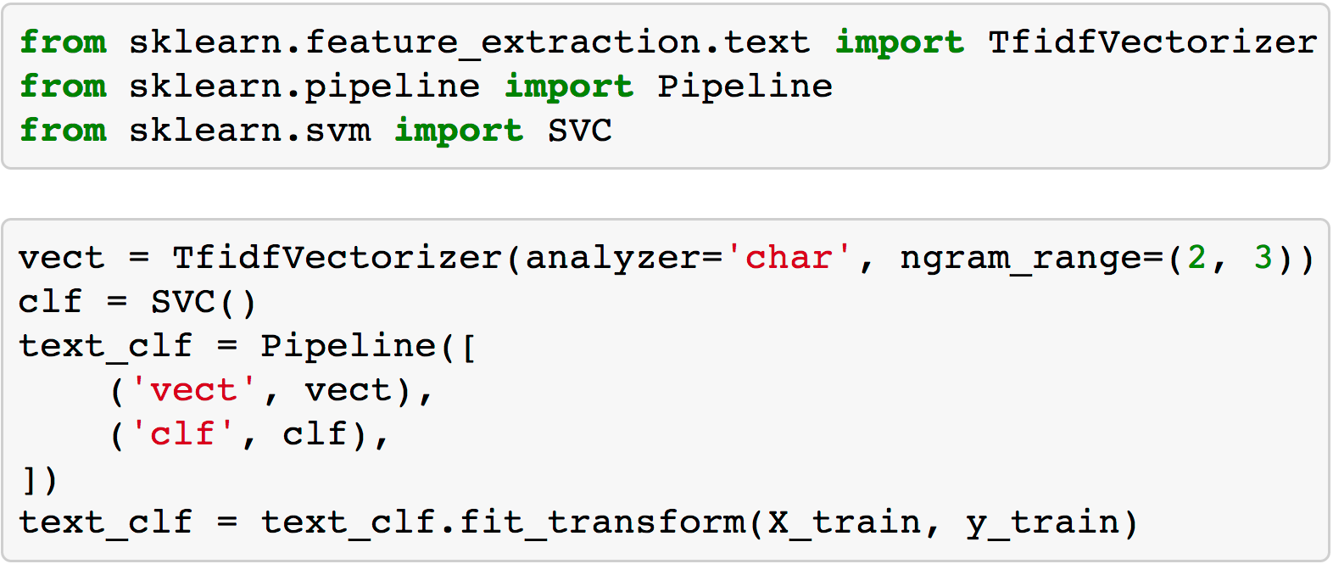
The Model
@beckerfuffle
#PyDataNYC
Notes:
(PAUSE) We call this type of algorithm a classifier because you provide some input and it classifies it as one of multiple classes. In the case of our algorithm, you provide some text as input, and it will classify the language of the text.

Slide 54
The Model
@beckerfuffle
#PyDataNYC
Notes:
To start off I've defined a pipeline combining a TfidfVectorizer with a SVC classifier. A pipeline is a utility used to build a multi-step classifier.

Slide 55
The Model
@beckerfuffle
#PyDataNYC
Notes:
The vectorizer converts Wikipedia articles into a numerical form by counting all the combinations of n character sequences in the dataset. These are called n-grams. It then applies the TF-IDF algorithm. The pipeline understands how to connect the output of the vectorizer to the input of the SVC algorithm.

Slide 56
The Model
@beckerfuffle
#PyDataNYC
Notes:
SVC is a classification algorithm called a Support Vector Classifier. It takes numerical data as input to its fit method. Once fitted, SVC can predict the label of new datapoints.

Slide 57
The Model
@beckerfuffle
#PyDataNYC
Notes:
The pipeline understands how to properly connect our vectorizer and our classifier together.

Slide 58
The Model
@beckerfuffle
#PyDataNYC
Notes:
All that’s left to do is fit our data to our model.
(PAUSE)
Let’s look a little closer and X_train and y_train.

Slide 59
Supervised Learning
@beckerfuffle
#PyDataNYC
Notes:
X_train is the portion of my data that I set aside for training.

Slide 60
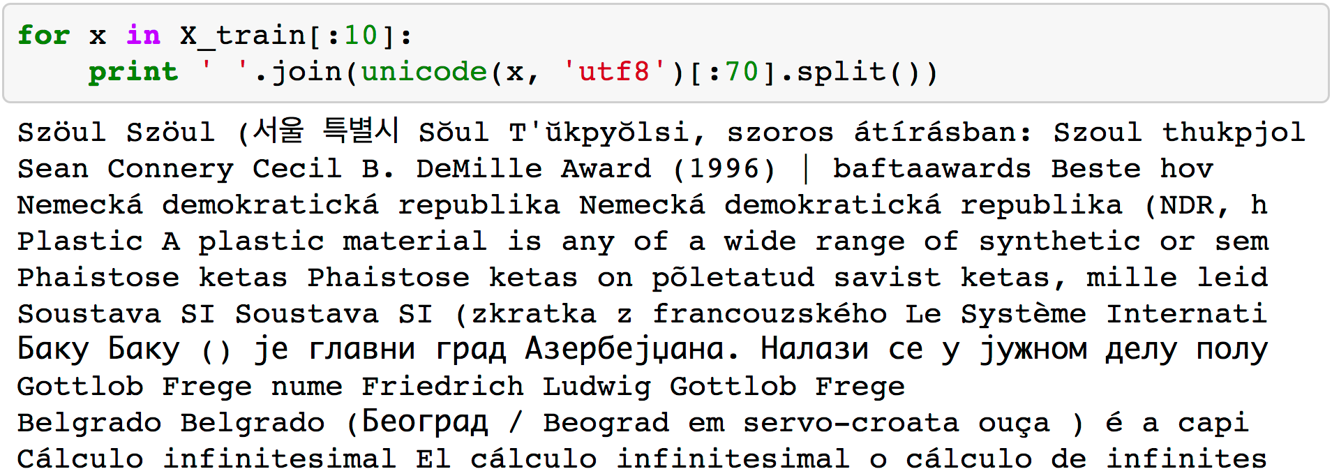
X_train
@beckerfuffle
#PyDataNYC
Notes:
(PAUSE) X_train is an array of text from the wikipedia articles... besides stripping out the wiki markup, I didn’t do anything else to prepare the data. The vectorizor handles converting the text to the numerical form required by the SVC algorithm.

Slide 61
Supervised Learning
@beckerfuffle
#PyDataNYC
Notes:
y_train is the labels for our training set.

Slide 62
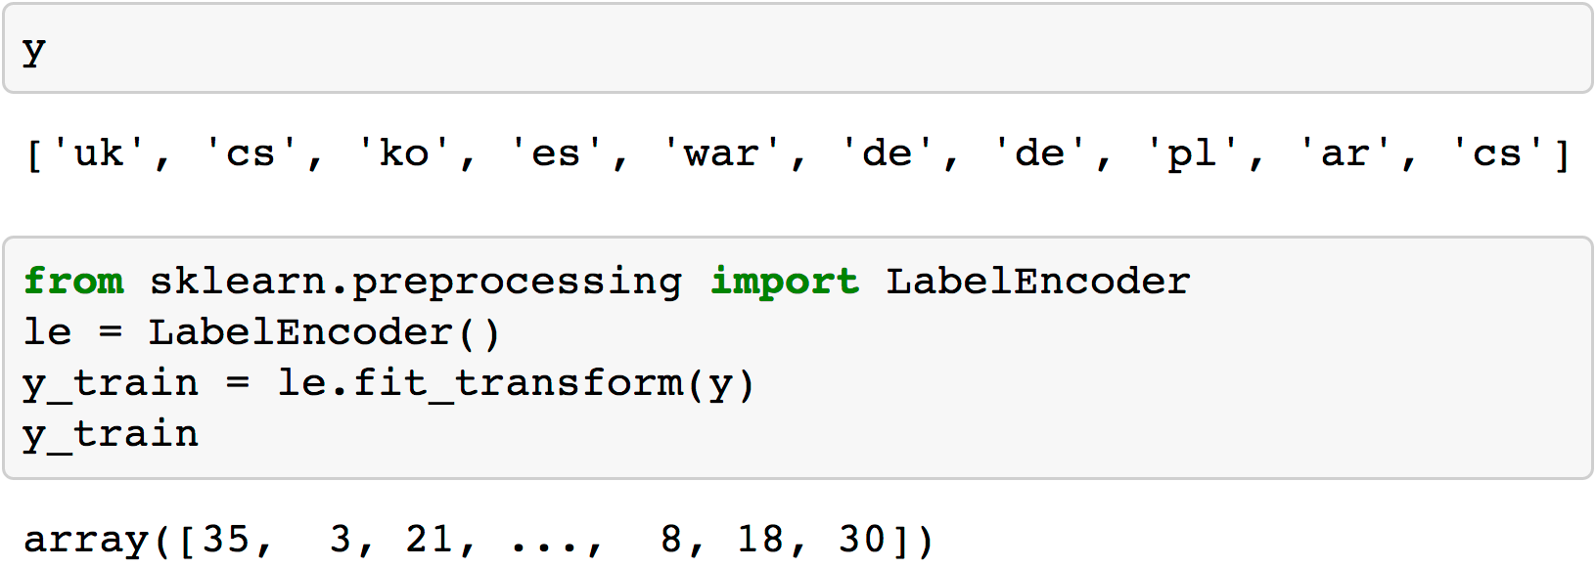
y_train
@beckerfuffle
#PyDataNYC
Notes:
y is a 1-dimensional array, in this case, it contains the language of each article. Unlike X_train, I do need to convert these to numerical form prior to passing them into the fit method.

Slide 63
y_train
@beckerfuffle
#PyDataNYC
Notes:
We can accomplish this using a LabelEncoder. LabelEncoder will take in our string labels and convert them to numerical categories.
(PAUSE)

Slide 64
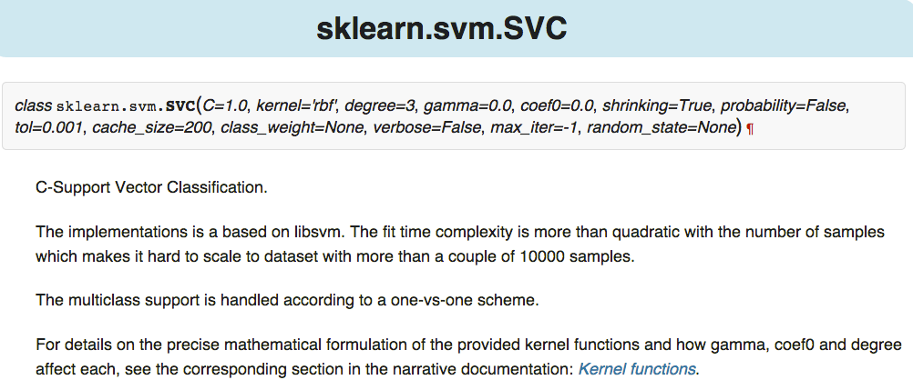
Tuning
@beckerfuffle
#PyDataNYC
Notes:
(PAUSE) scikit-learn comes with a ton of algorithms built-in, and many of them have multiple parameters you can tweak. It can be daunting to figure out which algorithm to use and what values to pick for the parameters.

Slide 65
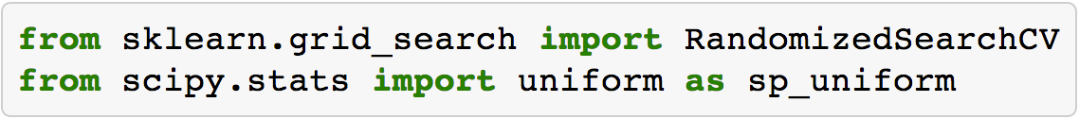
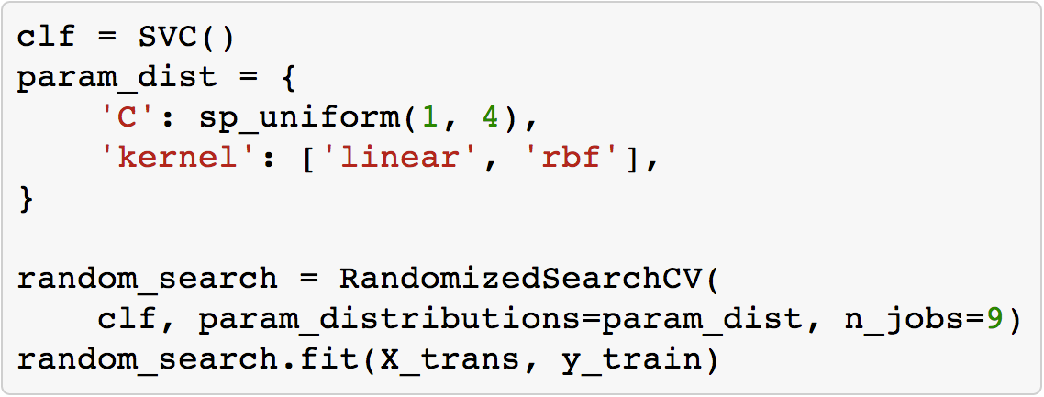
RandomizedSearchCV
@beckerfuffle
#PyDataNYC
Notes:
(PAUSE) Luckily there are tools built-in to scikit-learn to help you tune your model so that you get the best performance out of it. One such tool is RandomizedSearchCV. You give RandomizedSearchCV a range of values to try for each parameter. It then randomly chooses values and tests them.

Slide 66
RandomizedSearchCV
@beckerfuffle
#PyDataNYC
Notes:
The other thing RandomizeSearchCV does for you is it splits your training set into multiple random chunks called folds. It uses a random set of folds for training, and another set for testing the trained classifier. This is called Cross-validation. Cross-validation helps ensure that you’re accurately measuring the performance of your classifier.

Slide 67
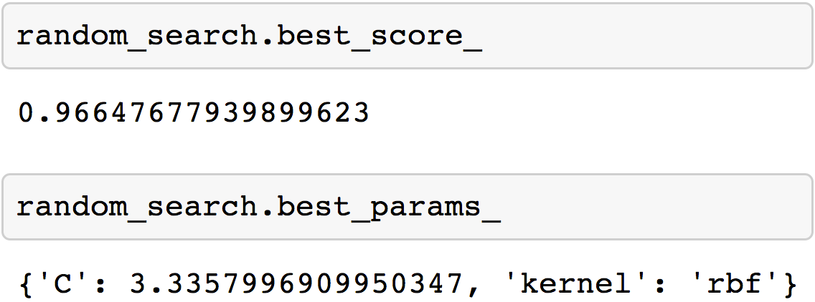
RandomizedSearchCV
@beckerfuffle
#PyDataNYC
Notes:
Once the search is complete, you can get the highest scoring classifier along with its score and parameters. You can easily run this kind of search on multiple algorithms to figure out which one will perform best for your particular dataset. (PAUSE)

Slide 68
sklearn.metrics
accuracy_score
classification_report
confusion_matrix
@beckerfuffle
#PyDataNYC
Notes:
Once you have a tuned model, it’s time to validate that it’s accurate. The metrics module of scikit-learn has several utility functions for measuring classifier performance. Let’s go through a few of my favorites.

Slide 69
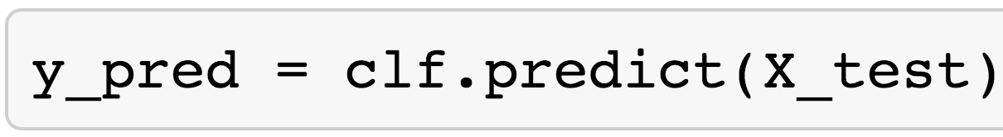
sklearn.metrics
accuracy_score
classification_report
confusion_matrix
@beckerfuffle
#PyDataNYC
Notes:
(PAUSE) For the purposes of testing our model, I’ve excluded some of the data from training. Generally speaking, you don’t want to train an algorithm using your full dataset because many algorithms can suffer from an issue called overfitting. Overfitting is when a model is very good at making predictions about your training set, but when presented with new data, it performs poorly.

Slide 70
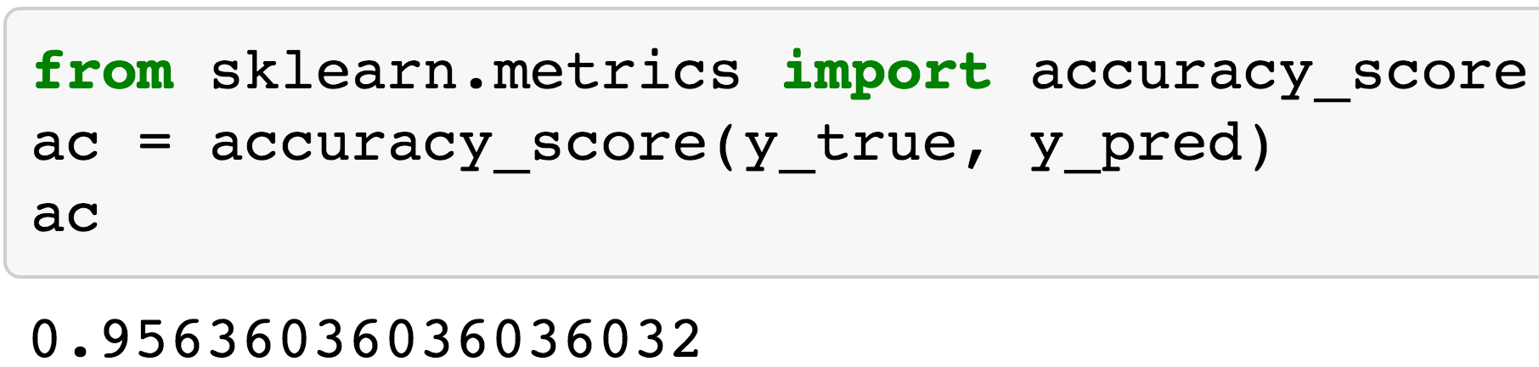
accuracy_score
@beckerfuffle
#PyDataNYC
Notes:
All the metrics functions I’ll show you take 2 lists as input. The first (y_true) contains the correct label for each sample in our test set. The second (y_pred) is the predicted labels for each sample.

Slide 71
accuracy_score
@beckerfuffle
#PyDataNYC
Notes:
accuracy is pretty much what it sounds like. It’s the overall percentage of correct classifications. 96% isn’t bad, but can we do better? (PAUSE)

Slide 72
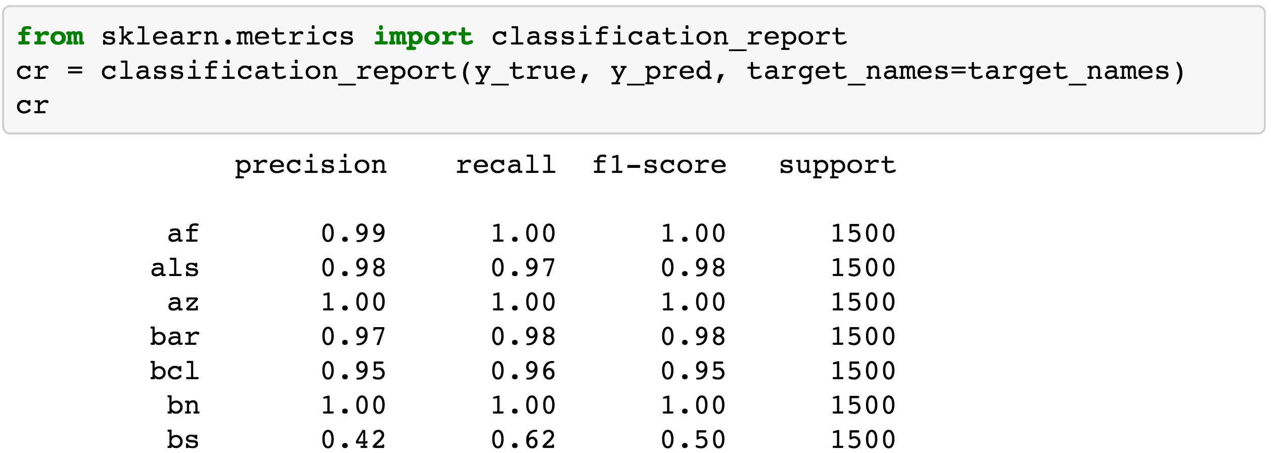
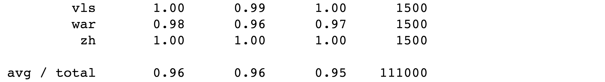
classification_report
@beckerfuffle
#PyDataNYC
Notes:
classification_report builds a text report showing “the main classification metrics.”

Slide 73
classification_report
@beckerfuffle
#PyDataNYC
Notes:
Ideally, precision, recall, and f1-score should all have values of 1.0 (with the worst values being 0.0). Support tells you the number of samples in each class.

Slide 74
classification_report
@beckerfuffle
#PyDataNYC
Notes:
Looking at the classification report I can see right away that there is something funny going on with the Bosnian language. You might recall from the Explore phase earlier that Bosnian was very similar to a few other languages. Could this be impacting our accuracy? (PAUSE)

Slide 75
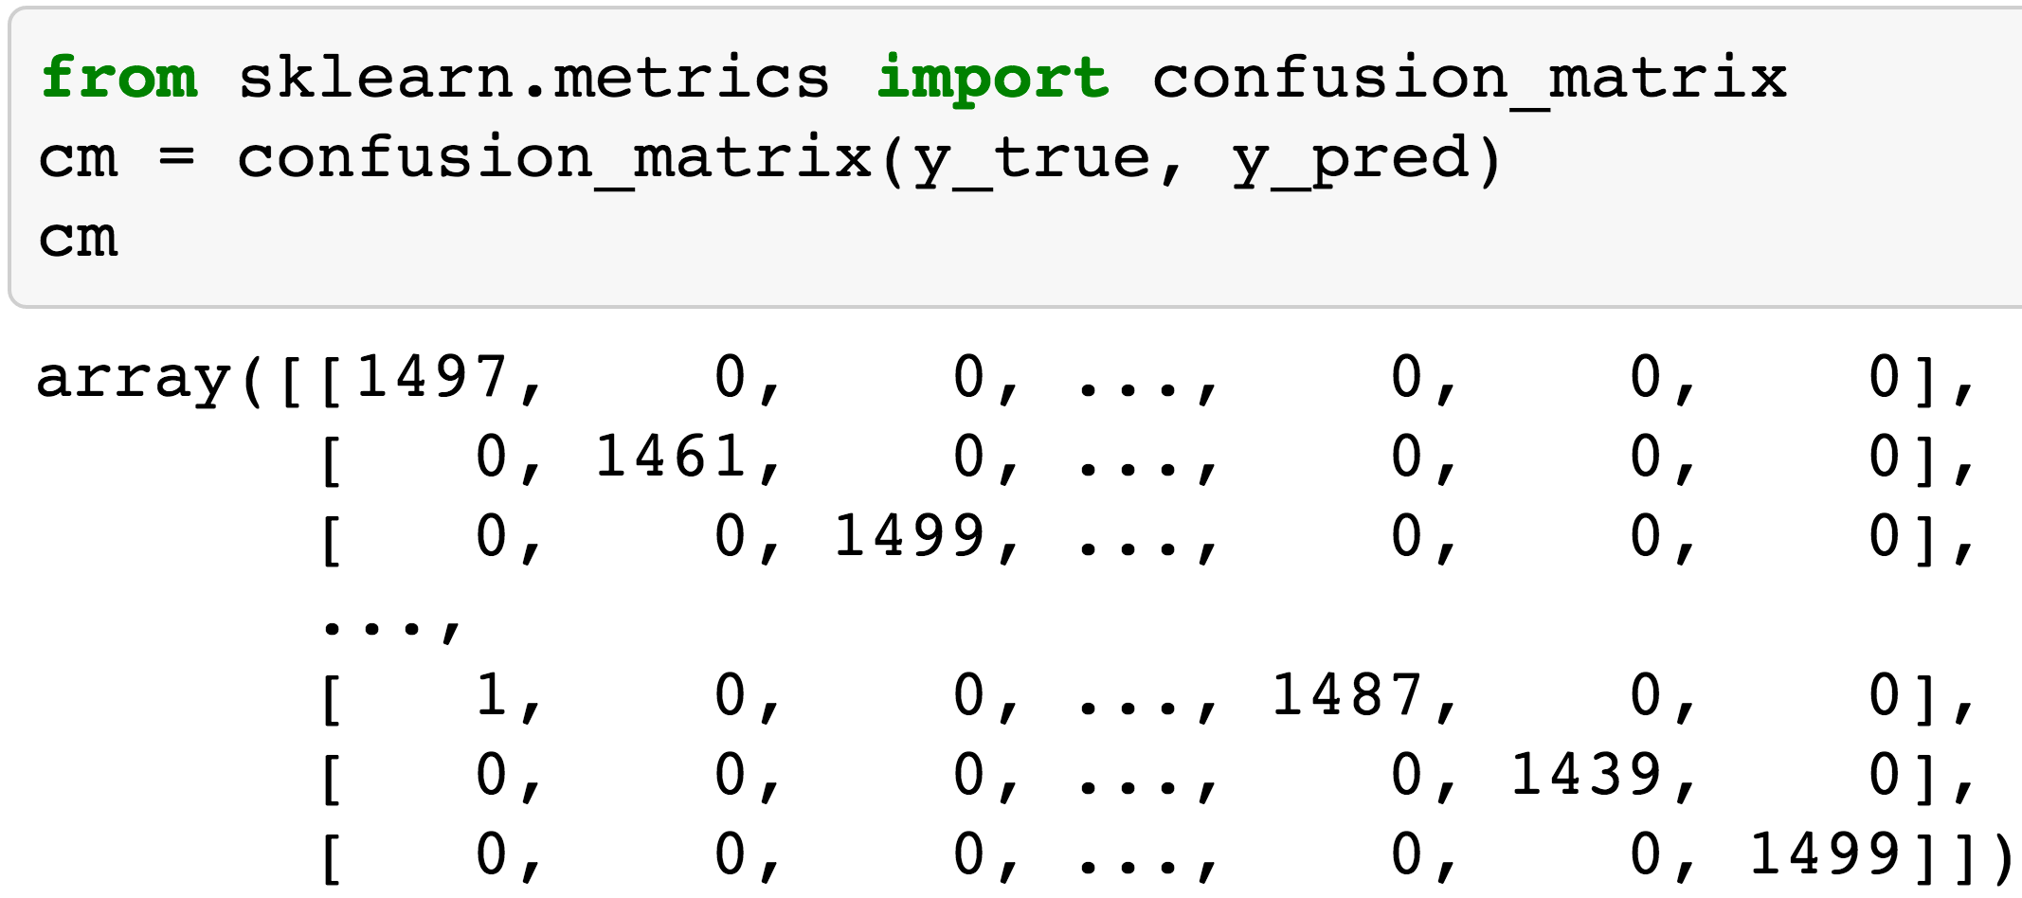
I’m Confused
@beckerfuffle
#PyDataNYC
Notes:
A good way to find patterns in the incorrectly classified data points is to use a confusion matrix.

Slide 76
I’m Confused
@beckerfuffle
#PyDataNYC
Notes:
Here’s what it looks like for our classifier. (PAUSE)
Well that’s not terribly useful. Let’s visualize it!

Slide 77
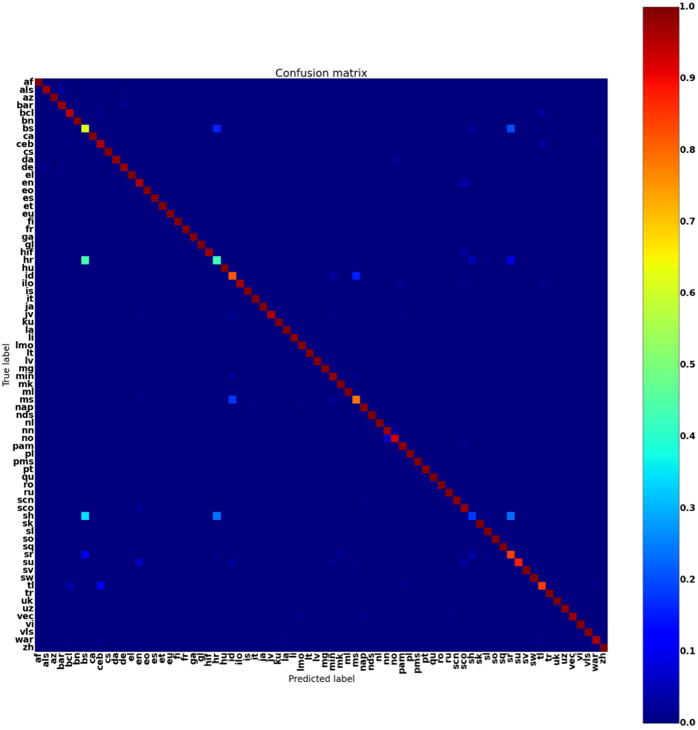
I’m Confused
@beckerfuffle
#PyDataNYC
Notes:
(PAUSE) Okay… a little better but this is probably pretty hard for you to read, so let’s have a closer look at some of the more interesting languages.

Slide 78
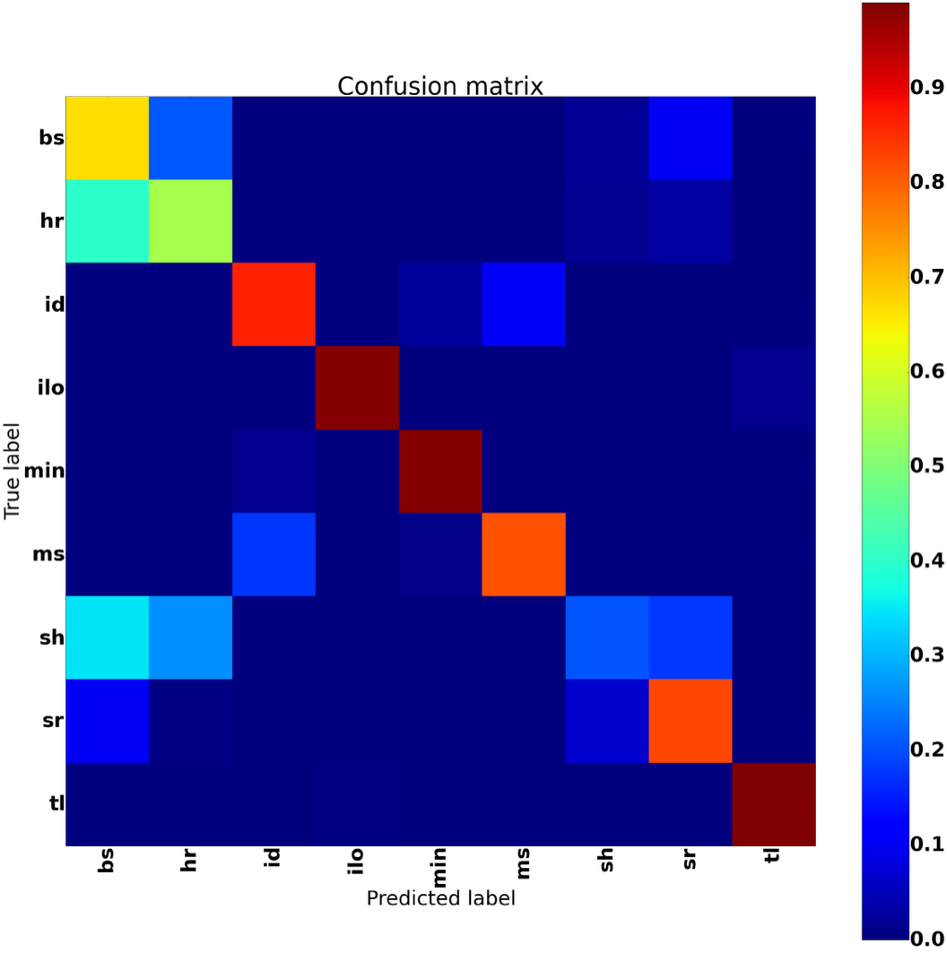
I’m Confused
@beckerfuffle
#PyDataNYC
Notes:
(PAUSE) Alright, so how do we interpret this? You’ll notice that each language shows up once on the y-axis and again on the x-axis. The y-axis shows the correct label. The x-axis shows the predicted label.

Slide 79
I’m Confused
@beckerfuffle
#PyDataNYC
Notes:
Anywhere where the prediction is correct, a cell on the diagonal will have its counter incremented.

Slide 80
I’m Confused
@beckerfuffle
#PyDataNYC
Notes:
If the prediction is incorrect, a cell off the diagonal will get it’s count incremented. This is a heatmap, so 100% is dark red, and 0% is dark blue. Ideally, we should see nothing but dark red along the diagonal, which would mean that our predictions were 100% correct, and dark blue everywhere else.

Slide 81
I’m Confused
@beckerfuffle
#PyDataNYC
Notes:
Going along the rows, we can see exactly what each language is being confused for. In this case we can see that bs, hr, sh, and sr are often being confused with each other. It turns out that these are Bosnian, Croatian, Serbo-Croatian, and Serbian. These languages are almost identical and used to all be called Serbo-Croatian prior to the Yugoslav Wars.

Slide 82
I’m Confused
@beckerfuffle
#PyDataNYC
Notes:
This gives us some clues as to how we can improve the performance of our classifier. According to Wikipedia, these languages are the same, so what if we treated them as a single language for the purposes of our language classifier?

Slide 83
y_train
@beckerfuffle
#PyDataNYC
Notes:
Doing this is pretty straight forward. All we have to do is go back to where we created y_train, and anywhere where our labels were bs, hr, sh, or sr, replace them with a new label. Then we can rerun the RandomSearchCV to retrain our model.

Slide 84
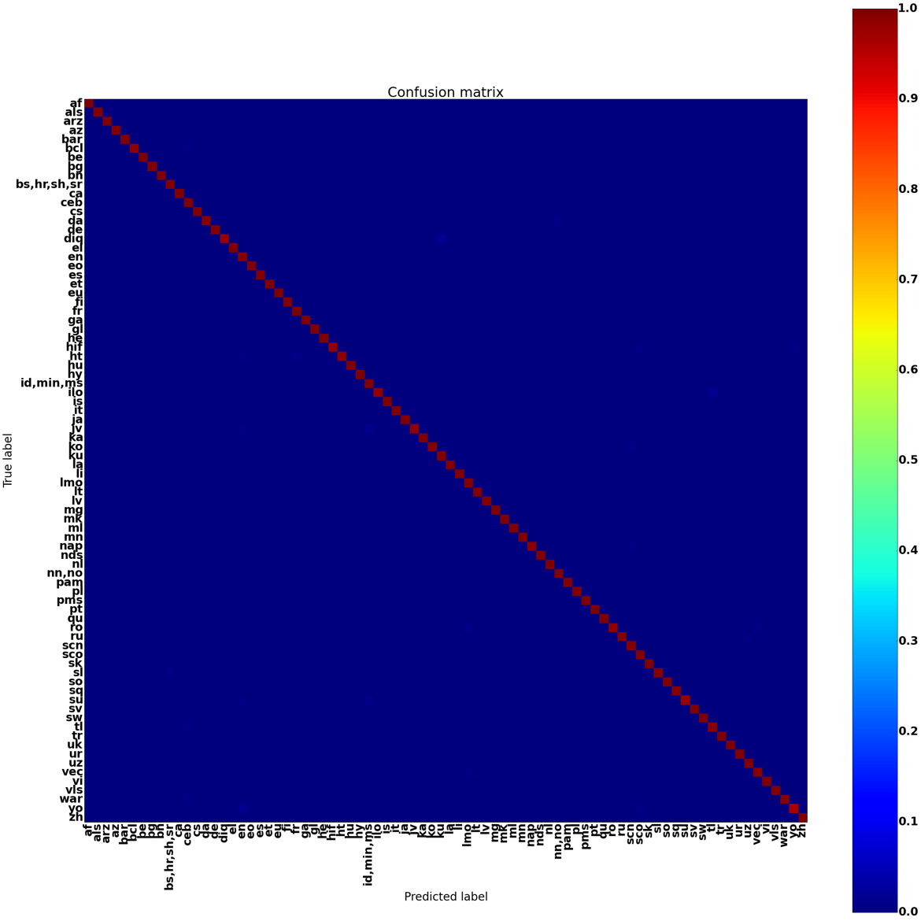
INterpret
@beckerfuffle
#PyDataNYC
Notes:
(PAUSE) After combining several similar languages, we’re able to easily get over 99% accuracy. For some of these languages, if we wanted to distinguish them, we could train more complex models just for them. Before devoting too much time into it, you should ask if it is worth the effort. It all comes down to your particular application. (PAUSE)

Slide 85


All The Things!
Twitter: @beckerfuffle
Blog: beckerfuffle.com
Github: github.com/mdbecker
Work with me: http://aweber.jobs
@beckerfuffle
#PyDataNYC
Notes:
All right, so that’s it, now you can all go onto LinkedIn and change your titles to Data Scientist! A lot of interesting stuff didn’t make it into this talk so I’ll be posting some followups to my talk on my blog. If you’re interested in receiving email updates from me, hit me up after the Q&A to signup for my mailing list!

